Slide 1


IACSD
INSTITUTE FOR ADVANCED COMPUTING AND SOFTWARE DEVELOPMENT AKURDI, PUNE
Documentation On
“Home Loan Service”
PG-DAC SEPT 2022
Submitted By:
Group No: 13
Name:
Abhiram Belorkar Shreyansh Ranka
Roll No. 229017
229091
Mr. Rohit Puranik
Centre Coordinator
Mr. Sonali Mogal
Project Guide

Slide 2
IACSD
ABSTRACT
The project entitled “Home Loan Service” is to be developed for maintaining the bank activities like, customer preferences, customer enquiry, interest rates, customer EMI, personal loan, mortgage loan, Home Loan, Customer follow ups details, customer feedback from entry and employee details.
The system is efficient in generating reports which will help in the maintaining records of the customer. Microfinance is a project which has become a mainstream instrument for providing access to formal financial services for common people. This project is developed to maintain all the details of the users and to develop online portal

Slide 3
IACSD
ACKNOWLEDGEMENT
I take this occasion to thank God, almighty for blessing us with his
grace and taking our endeavor to a successful culmination. I extend my sincere
and heartfelt thanks to our esteemed guide, Mr. Sonali Mogal for providing me with the right guidance and advice at the crucial juncture sand for showing me the right way. I extend my sincere thanks to our respected Centre Co-Ordinator Mr. Rohit Puranik, for allowing us to use the facilities available. I would like to thank the other faculty members also, at this occasion. Last but not the least, I would like to thank my friends and family for the support and encouragement they have given me during the course of our work.
Abhiram Belorkar (229017)
Shreyansh Ranka (229091)

Slide 4
IACSD
Table of Contents
ABSTRACT................................................................................................................................... 2
ACKNOWLEDGEMENT............................................................................................................ 3
INTRODUCTION......................................................................................................................... 7
FEATURES ................................................................................................................................... 7
PROJECT OBJECTIVE................................................................................................... 8
PROJECT OVERVIEW ................................................................................................... 8
PROJECT SCOPE ................................................................................................................. 9
STUDY OF THE SYSTEM ................................................................................................... 9
MODULES .................................................................................................................... 9
SYSTEM ANALYSIS................................................................................................................. 19
EXISTING SYSTEM ........................................................................................................... 19
PROPOSED SYSTEM ......................................................................................................... 19
SYSTEM REQUIREMENT SPECIFICATION................................................................ 19
GENERAL DESCRIPTION..................................................................................... 19
SYSTEM OBJECTIVES ........................................................................................... 20
SYSTEM REQUIREMENTS................................................................................... 20
MODERATOR............................................................................................................................ 23
DESCRIPTION OF FEATURES.............................................................................................. 23 ADMIN ........................................................................................................................................ 23
SYSTEM DESIGN...................................................................................................................... 25
INPUT AND OUTPUT DESIGN ........................................................................................ 25
INPUT DESIGN ........................................................................................................ 25
OUTPUT DESIGN .................................................................................................... 25
DATABASE DESIGN ................................................................................................................ 27
DATABASE........................................................................................................................... 27
SYSTEM TOOLS ................................................................................................................. 27
FRONT END.............................................................................................................. 27
BACKEND ................................................................................................................. 27

Slide 5
IACSD
1 LEVEL DFD FOR ADMIN .................................................................................................... 28
1 LEVEL DFD FOR CUSTOMER ........................................................................................... 29
E-R DIAGRAM........................................................................................................................... 30
CLASS DIAGRAM..................................................................................................................... 31
TABLE STRUCTURE ............................................................................................................... 32
PROJECT DIAGRAMS............................................................................................................. 37
CONCLUSION ........................................................................................................................... 54
REFERENCES............................................................................................................................ 55

Slide 6
IACSD
LIST OF FIGURES
FIGURE 1: ADMIN ACTIVITY DIAGRAM ------------------------------------------------------------11
FIGURE 2: SUPPLIER ACTIVITY DIAGRAM -------------------------------------------------------- 13
FIGURE 3: CUSTOMER ACTIVITY DIAGRAM ----------------------------------------------------- 15
FIGURE 4: DELIVERY BOY ACTIVITY DIAGRAM-------------------------------------------------17
FIGURE 5: 1 LEVEL DFD FOR ADMIN ----------------------------------------------------------------- 28
FIGURE 6: 1 LEVEL DFD FOR CUTOMER------------------------------------------------------------29
FIGURE 7: E-R DIAGRAM ---------------------------------------------------------------------------------- 30
FIGURE 8: CLASS DIAGRAM ---------------------------------------------------------------------------- 31
FIGURE 9: TABLE STRUCTURE ------------------------------------------------------------------------ 32
FIGURE 10: PROJECT DIAGRAMS --------------------------------------------------------------------- 37

Slide 7
IACSD
INTRODUCTION
A home loan is a secured loan that is obtained to purchase a property by offering it as collateral. Home loans offer high-value funding at economical interest rates and for long tenors. They are repaid through EMIs. After repayment, the property's title is transferred back to the borrower.
The project objective is to create a web-based application for banks and financial institutions to manage home loan applications from their administrative backend. The backend will be responsible for managing the loan application process, which includes validating user inputs, processing applications, and storing data in a database. The frontend will be user-friendly, with a dashboard that provides an overview of all applications, filters to search for specific loan applications, and features for managing applications such as approving or rejecting them, updating their statuses, and sending notifications to applicants. This software is primarily aimed at individuals who are interested in obtaining a home loan from a bank. Its purpose is to simplify the loan application process and make it easier for banks to manage and process applications.
Features: -
Ensure data accuracy.
Proper control of the higher officials.
Minimize manual data entry.
Minimum time needed for the various processing.
Greater efficiency.
Better service.
User friendliness and interactive.
Minimum time required.

Slide 8
IACSD
PROJECT OBJECTIVE
The main objective of this project is to buy a Home through finance Loan Company and to implement all the loan process by developing a code. First here, if we want to buy a Home then we will go to Builder, and he will explain the whole process to us and gives a quotation. If we do not have that much money in current situation, then he will suggest us to take a loan. As already some banks have tied up with them e.g., ICICI, HDFC, SBI, and some other finance companies. Then they will suggest us those providers and there’s one relation executive person will contact you and explain all the process of Loan. Every bank has different process.
PROJECT OVERVIEW
The central concept of the application is to allow the customer to shop virtually using the internet and allow customers to buy the items and articles of their desire from the store. The information pertaining to the products are stores on an RDBMS at the server side (store).
The server processes the customers, and the items are shipped to the address submitted by them. The application was designed into two modules first is for the customers who wish to buy the articles. Second is for the storekeepers who maintains and updates the information pertaining to the articles and those of this product is a departmental store wherethe application is hosted on the web and the administrator maintains the database. The application, which is deploy the customer database, the details of the items are brought forward from the database for the customer view based on the selection through the menu and the database of all the products are updated at the end of each transaction. Data entry into the application can be done through various screens designed for various levels of users. Once the authorized personal feed the relevant data into the system, several reports could be generated as per the security.

Slide 9
IACSD
PROJECT SCOPE
The main purpose to build this application program is to reduce the human efforts by using software. The project is totally built at administrative end and thus only the administrators guaranteed will access this system. This software is a mainly related to customer individuals who are interested in taking Home Loan from bank to fulfil their dreams. The process is filter by position to Official position.
STUDY OF THE SYSTEM
MODULES:
The system after careful analysis has been identified to be presented with the following modules and roles.
The modules involved are:
Administrator
Loan Disbursement
Ledger Generate
Telecaller Head
Administrator:
The administrator is divided into four parts. Only admin have access into this admin page. The administrator has all the information about the users and about all products.
This module is divided into different sub modules.
Loan Officer
Operational Executive
Account Head
Credit Manager

Slide 10
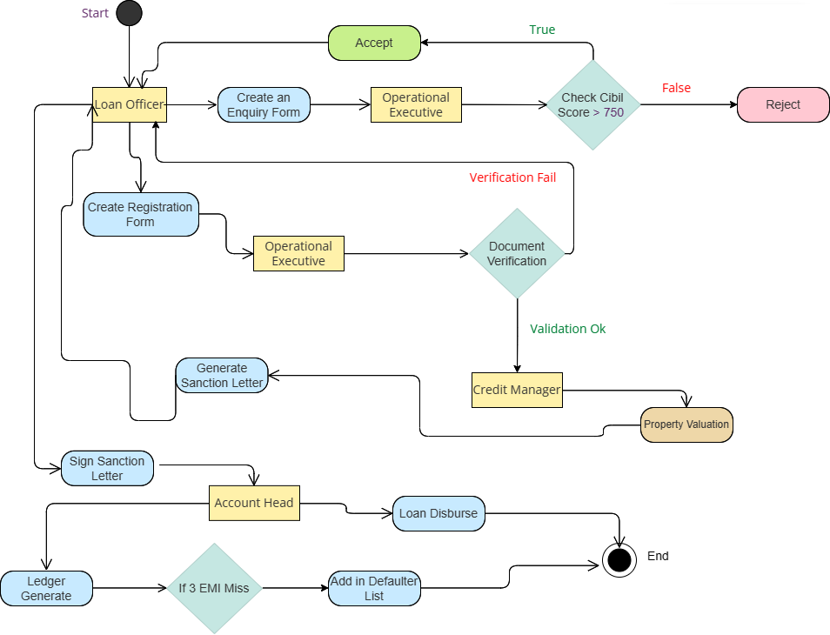
IACSD
Figure 1 Activity Diagram

Slide 11
IACSD
Create an Enquiry form
Loan officer will fill the enquiry form of the customer during his/her physical presence.
Create Registration Form
After customer is interested in taking the loan and have valid CIBIL score, loan officer will create registration form for the customer.
Generate Sanction Letter
After property valuation credit will generate the sanction letter
Sign Sanction Letter
After verification is done and approved by credit manager, loan officer will sign the sanction letter for loan disbursement.
Loan Disburse
After signing the sanction letter, account head will be disburse the loan to the customer.
Ledger Generate
Account head will generate the ledger to keep an eye on customer’s EMI payment regularly.
Add in Defaulter list
If customer is not able to pay continuous three EMI, customer will be added to the defaulter list

Slide 12
IACSD
SYSTEM ANALYSIS
System analysis is the process of gathering and interpreting facts, diagnosing problems, and using the information to recommend improvements on the system. System analysis is a problem-solving activity that requires intensive communication between the system users and system developers.
System analysis or study is an important phase of any system development process. The system is viewed as a whole, the inputs are identified, and the system is subjected to close study to identify the problem areas. The solutions are given as a proposal. The proposal is reviewed on user request and suitable changes are made. This loop ends as soon as the user is satisfied with the proposal.
PROPOSED SYSTEM
The proposed software will solve all the problems they are facing now. Loan is still perceived as a huge burden for many countries. While loans are known to take off that burden off, it still gives nightmare to people, and they avoid availing a personal loan. However, a loan can be a solution to many of your financial problems.
A Microfinance helps you purchase a Home loan, Personal loan or Goods of your choice and pay for it in equated monthly instalments (EMIs). Personal loans are available for both salaried and self-employed individuals. You will come to us where our representative will help you complete the formalities and inform you if you are eligible for a loan on the spot. Once your loan application has been approved you can get your loan amount in short period of time
SYSTEM REQUIREMENT SPECIFICATION
GENERAL DESCRIPTION
Product Description:
The system is provided for easy access of customer enquiries and loan application status of the customer. Through this web application, bank administration can easily know about the application status and help them to take next step required to fast forward the application for further process.

Slide 13
IACSD
SYSTEM OBJECTIVES
To provide a Web application for Home Loan Service.
To provide an easy access to customer information for processing loan.
SYSTEM REQUIREMENTS
NON-FUNCTIONAL REQUIREMENTS
SECURITY Measures to protect sensitive personal and financial information from unauthorized access, theft, or damage. Multiple layers of cyber security to reduce financial losses from the hackers.
Multiple incorrect logins should lead to temporary deactivation of account, which can lower risk of theft or misuse data. System will provide access to content and operations using role-based security (Authorization) and (Permission based on roles)
SCALABILITY
The ability to handle increased demand for the service without significant performance degradation and able to reply to the user in minimum amount of time. The load on the server should not cause strain on the system resources.
AVAILABILITY
The service should be available for use at all times, with minimal downtime for maintenance or updates.
USABILITY
The service should be easy for customers to use, with a clear and intuitive user interface. the user-friendly UI will also lead to scalability of the product. The service should be accessible to customers with disabilities, in compliance with relevant laws and guidelines.

Slide 14
IACSD
PERFORMANCE
The service should be fast and responsive to the client. The service should be given with minimal delays or errors to the client.
MAINTENANCE
The service should be easy to maintain and update, with clear documentation and procedures. This refers to all those requirements that relate to the ease with which an end user might be least affected even during the course of a maintenance activity.
SUPPORT
The service should have a dedicated support team available to assist customers with any issues or questions.
2. Functional Requirement
LOAN OFFICER LOGIN
Loan officer want the information of customer who require the loan for their dream home. And the details over to the Operational executive. After the succulence status given by Credit Manager whom customer whose is valid again handover to loan officer.
OPERATIONAL EXECUTIVE LOGIN
Operational Executive is mean to give the result status about primary document verification. Customer who failed to submit their primary document their legal action taken and responsible by operational executive. After the document verification the customer case is handover to credit manager.

Slide 15
IACSD
CREDIT MANAGER
The Credit manager is highly responsible official body who undertakes the physical property evaluation on the basis of municipal corporation rules. After the completion of evaluation on the basis of rules and regulation the precision letter which is sanction letter is generated by credit manager. Then the credit manager is responsible to handover customer's case again to the loan officer.
ACCOUNT HEAD
The Account head is Higher authority. The requested customer who legally agrees to terms and conditions of basic rules of loan management, and signed their autogenerated sanction letter given to the admin head. Then it admin head responsibility to assign loan amount or disburse the loan amount on the basis of their overall future funds requirement. Continue to the regular loan period if three consecutive EMI missed by the customer, they will be added in defaulter list and directly assessed by account head.

Slide 16
IACSD
SYSTEM DESIGN
System design is the solution for the creation of a new system. This phase focuses on the detailed implementation of the feasible system. Its emphasis on translating design. Specifications to performance specification. System design has two phases of development.
Logical Design
Physical Design
During logical design phase the analyst describes inputs (sources), outputs(destinations), databases (data sores) and procedures (data flows) all in a format that meets the user requirements. The analyst also specifies the needs of the user at a level that virtually determines the information flow in and out of the system and the data resources. Here the logical design is done through data flow diagrams and database design. The physical design is followed by physical design or coding. Physical design produces the working system by defining the design specifications, which specify exactly what the candidate system must do. The programmers write the necessary programs that accept input from the user, perform necessary processing on accepted data and produce the required report on a hard copy or display it on the screen.
INPUT AND OUTPUT DESIGN
INPUT DESIGN:
Input design is the link that ties the information system into the world of its users. The input design involves determining the inputs, validating the data, minimizing the data entry and provides a multi-user facility. Inaccurate inputs are the most common cause of errors in data processing. Errors entered by the data entry operators can be controlled by input design. The user-originated inputs are converted to a computer-based format in the input design. Input data are collected and organized into groups of similar data. Once identified, the appropriate input media are selected for processing. All the input data are validated and if any data violates any conditions, the user is warned by a message. If the data satisfies all the conditions, it is transferred to the appropriate tables in the database. In this project the student details are to be entered at the time of registration. A page is designed for this purpose which is user friendly and easy to use. The design is done such that users get appropriate messages when exceptions occur.
OUTPUT DESIGN:
Computer output is the most important and direct source of information to the user. Output design
is a very important phase since the output needs to be in an efficient manner. Efficient and intelligible output design improves the system relationship with the user and helps in decision making. Allowing the user to view the sample screen is important because the user is the ultimate judge of the quality of output. The output module of this system is the selected notifications.

Slide 17
IACSD
DATABASE DESIGN
DATABASE
Databases are the storehouses of data used in the software systems. The data is stored in tables inside the database. Several tables are created for the manipulation of the data for the system. Two essential settings for a database are
Primary key - the field that is unique for all the record occurrences
Foreign key - the field used to set relation between tables
Normalization is a technique to avoid redundancy in the tables.
SYSTEM TOOLS
The various system tools that have been used in developing both the front end and the back end of the project are being discussed in this chapter.
FRONT END:
React is a library which is developed by Facebook are utilized to implement the frontend. React (also known as React.js or ReactJS) is a free and open-source front-end JavaScript library for building user interfaces or UI components. It is maintained by Facebook and a community of individual developers and companies. React can be used as a base in the development of single page or mobile applications. However, React is only concerned with state management and rendering that state to the DOM, so creating React applications usually requires the use of additional libraries for routing, as well as certain client-side functionality.
BACKEND:
The back end is implemented using MySQL which is used to design databases.
MySQL:
MySQL is the world's second most widely used open-source relational database management system (RDBMS). The SQL phrase stands for Structured Query Language. An application software called Navicert was used to design the tables in MySQL.
Spring-Boot:

Slide 18
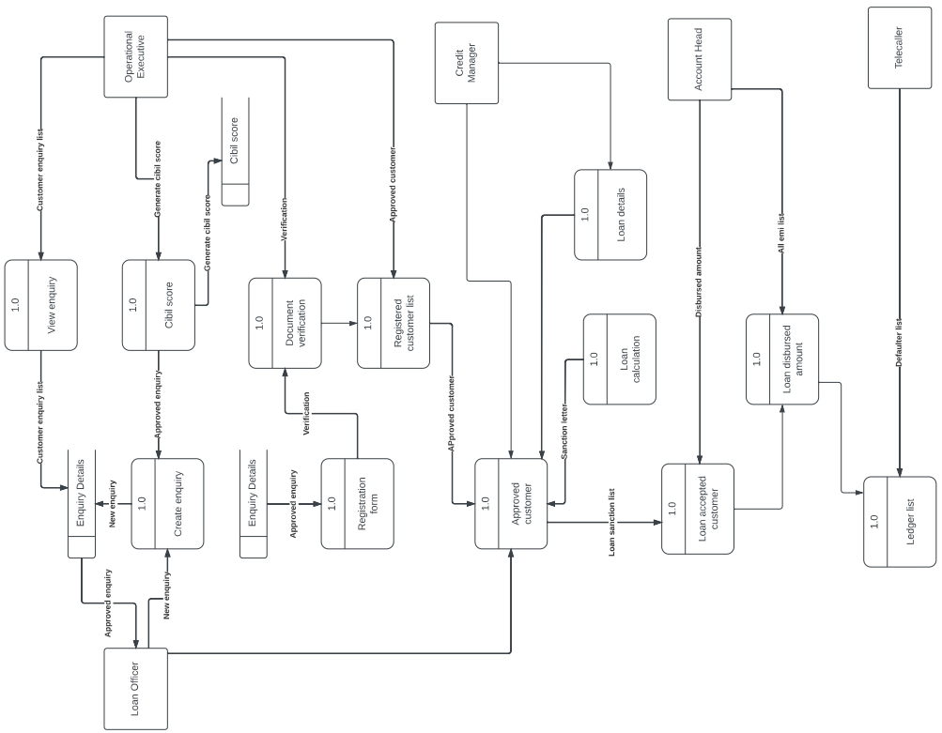
IACSD
This is used to connect MYSQL and fetch data from database and store the data in database. The Spring Framework is an application framework and inversion of control container for the Java platform. The framework's core features can be used by any Java application, but there are extensions for building web applications on top of the Java EE (Enterprise Edition) platform. Although the framework does not impose any specific programming model, it has become popular in the Java community as an addition to the Enterprise JavaBeans (EJB) model. The Spring Framework is Open-source Framework.
DFD
Figure 5 1 Level DFD for ADMIN

Slide 19
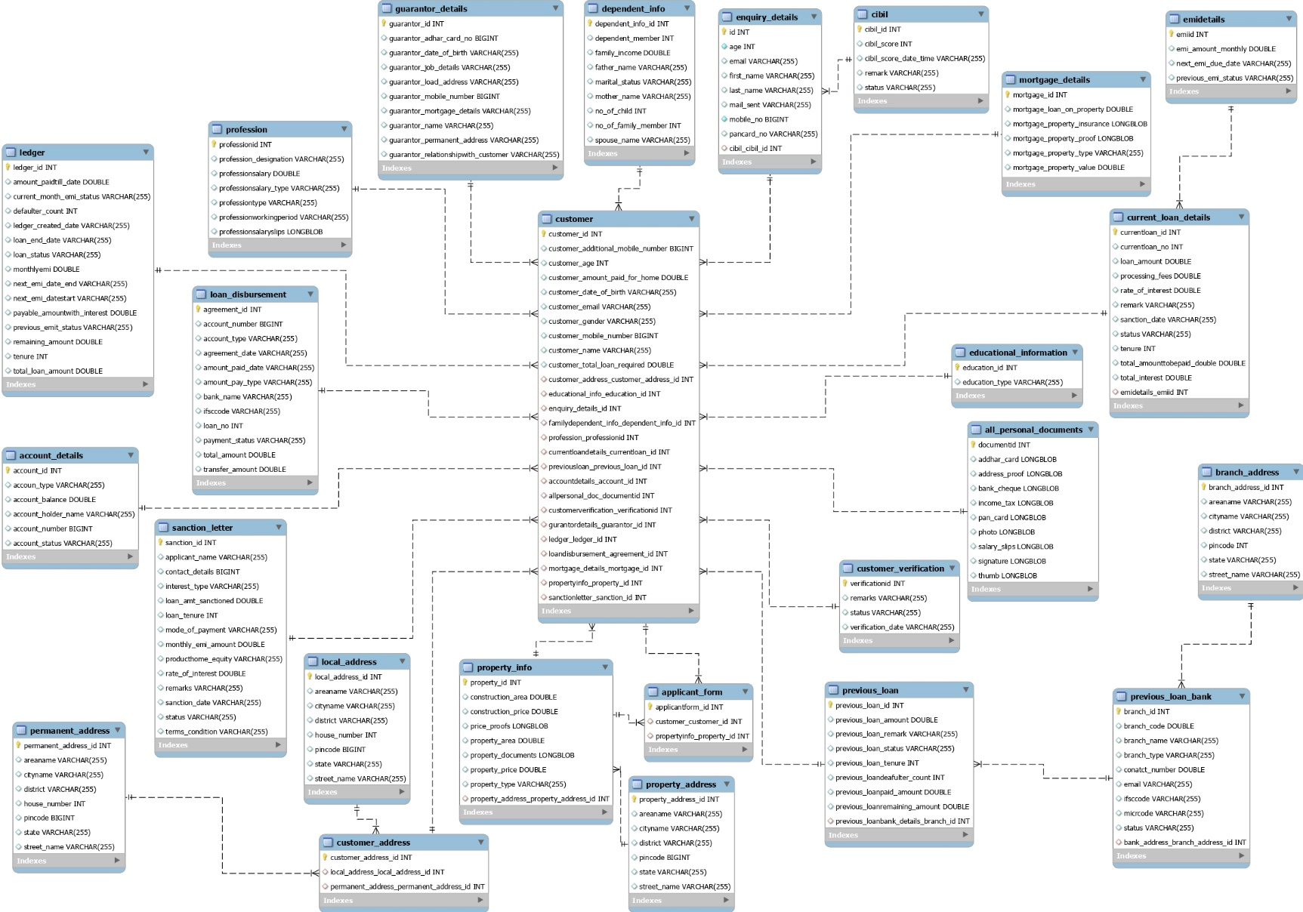
IACSD
E-R Diagram:
Figure 7 E-R Diagram

Slide 20
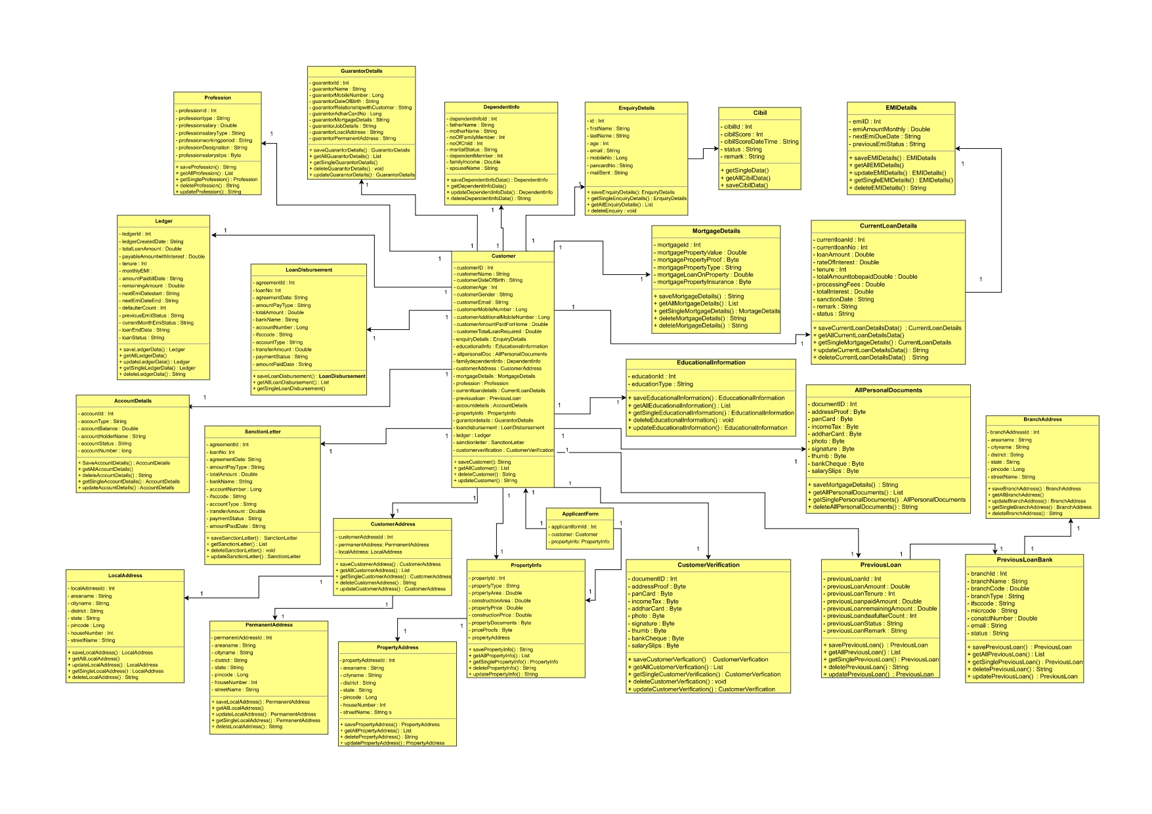
IACSD
Class Diagram
Figure 8 Class Diagram

Slide 21
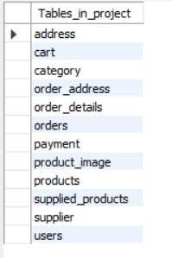
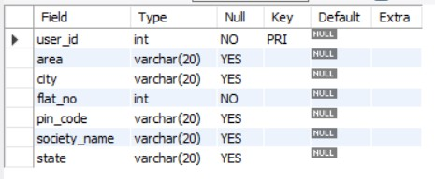
IACSD
TABLE STRUCTURE:
Tables:
Address:

Slide 22
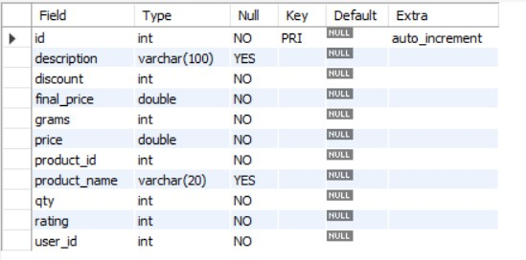
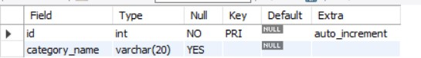
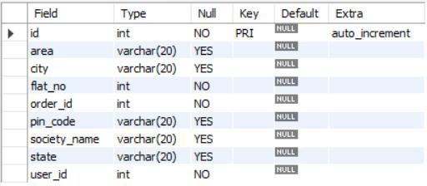
IACSD
Cart:
Category:
Order Address:

Slide 23
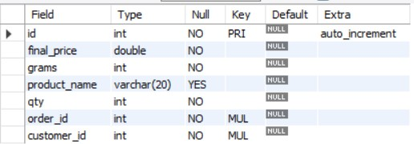
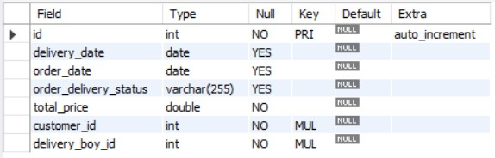
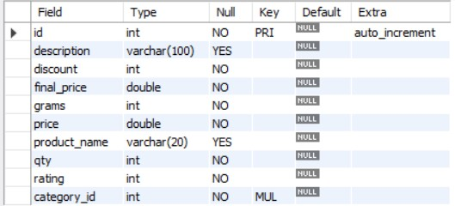
IACSD
Order Details:
Orders:
Products:

Slide 24
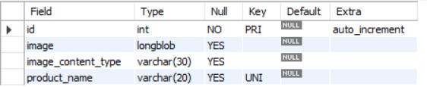
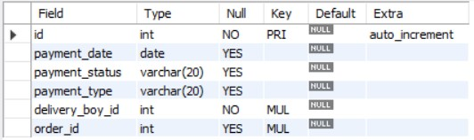
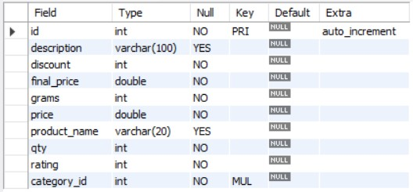
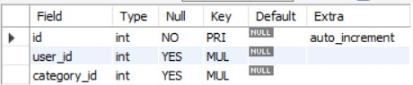
IACSD
Product Image:
Payment:
Supplied Products:
Supplier:

Slide 25
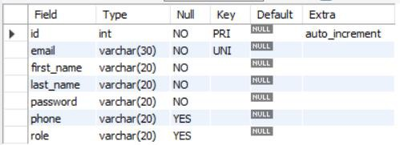
IACSD
Users:

Slide 26
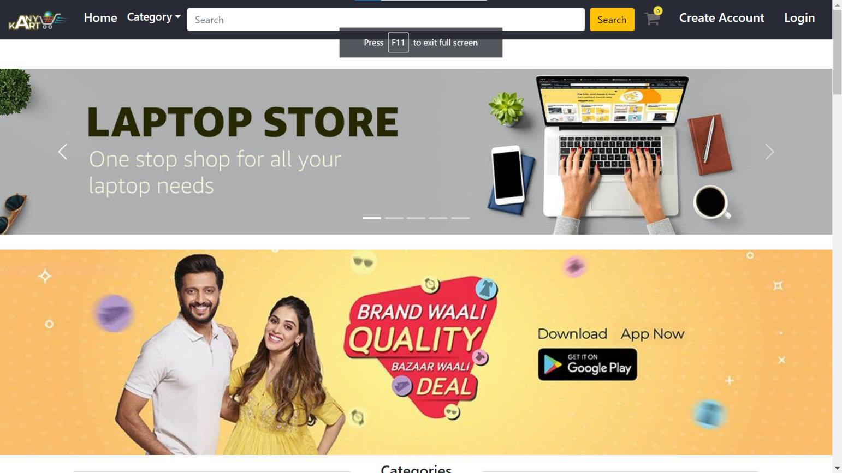
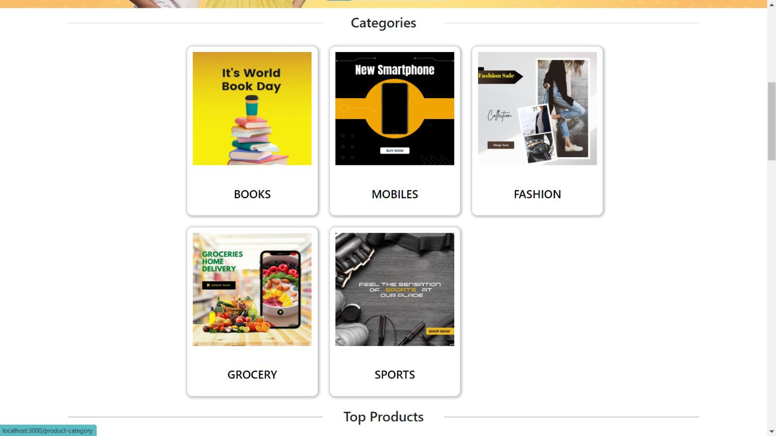
IACSD
PROJECT DIAGRAMS

Slide 27
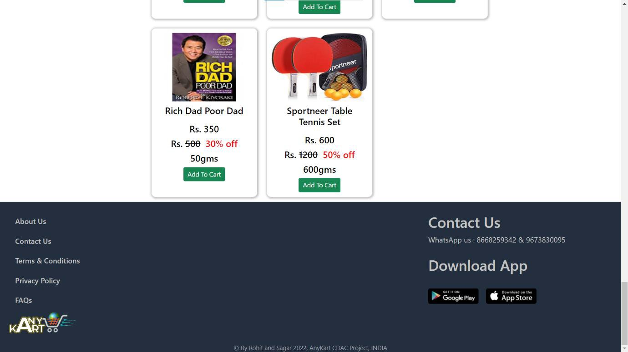
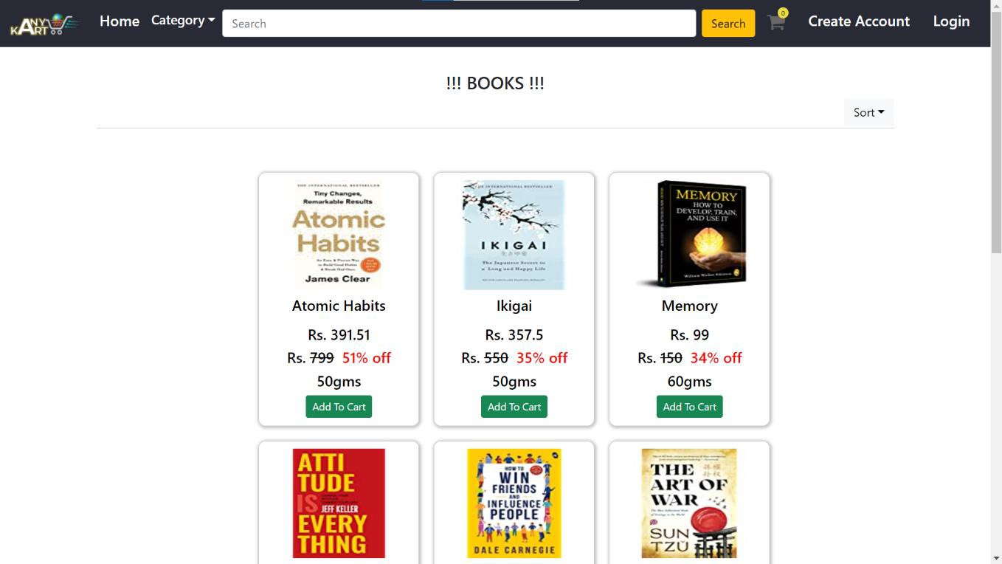
IACSD

Slide 28
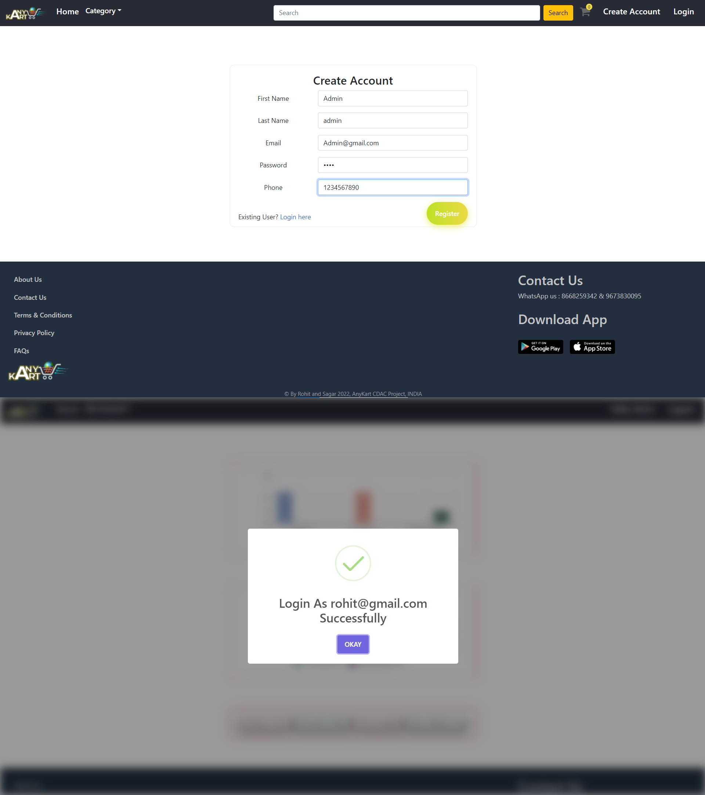
IACSD

Slide 29
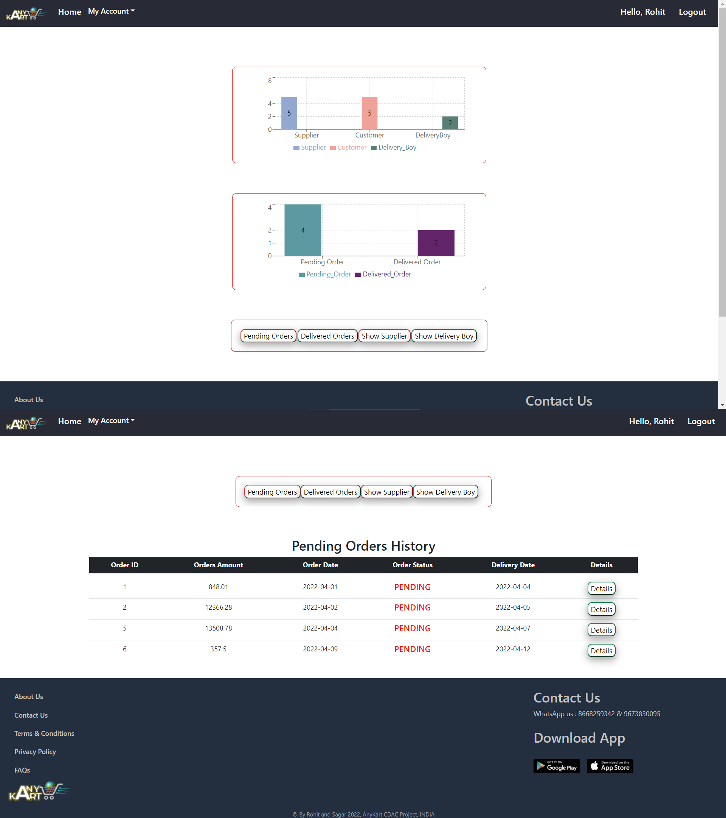
IACSD

Slide 30
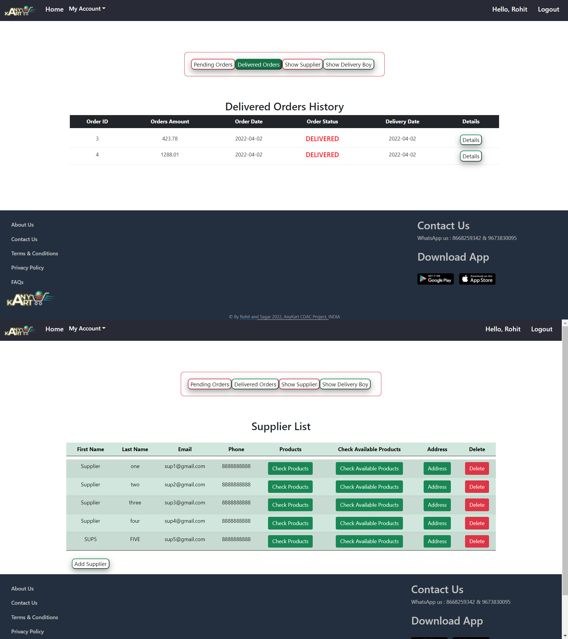
IACSD

Slide 31
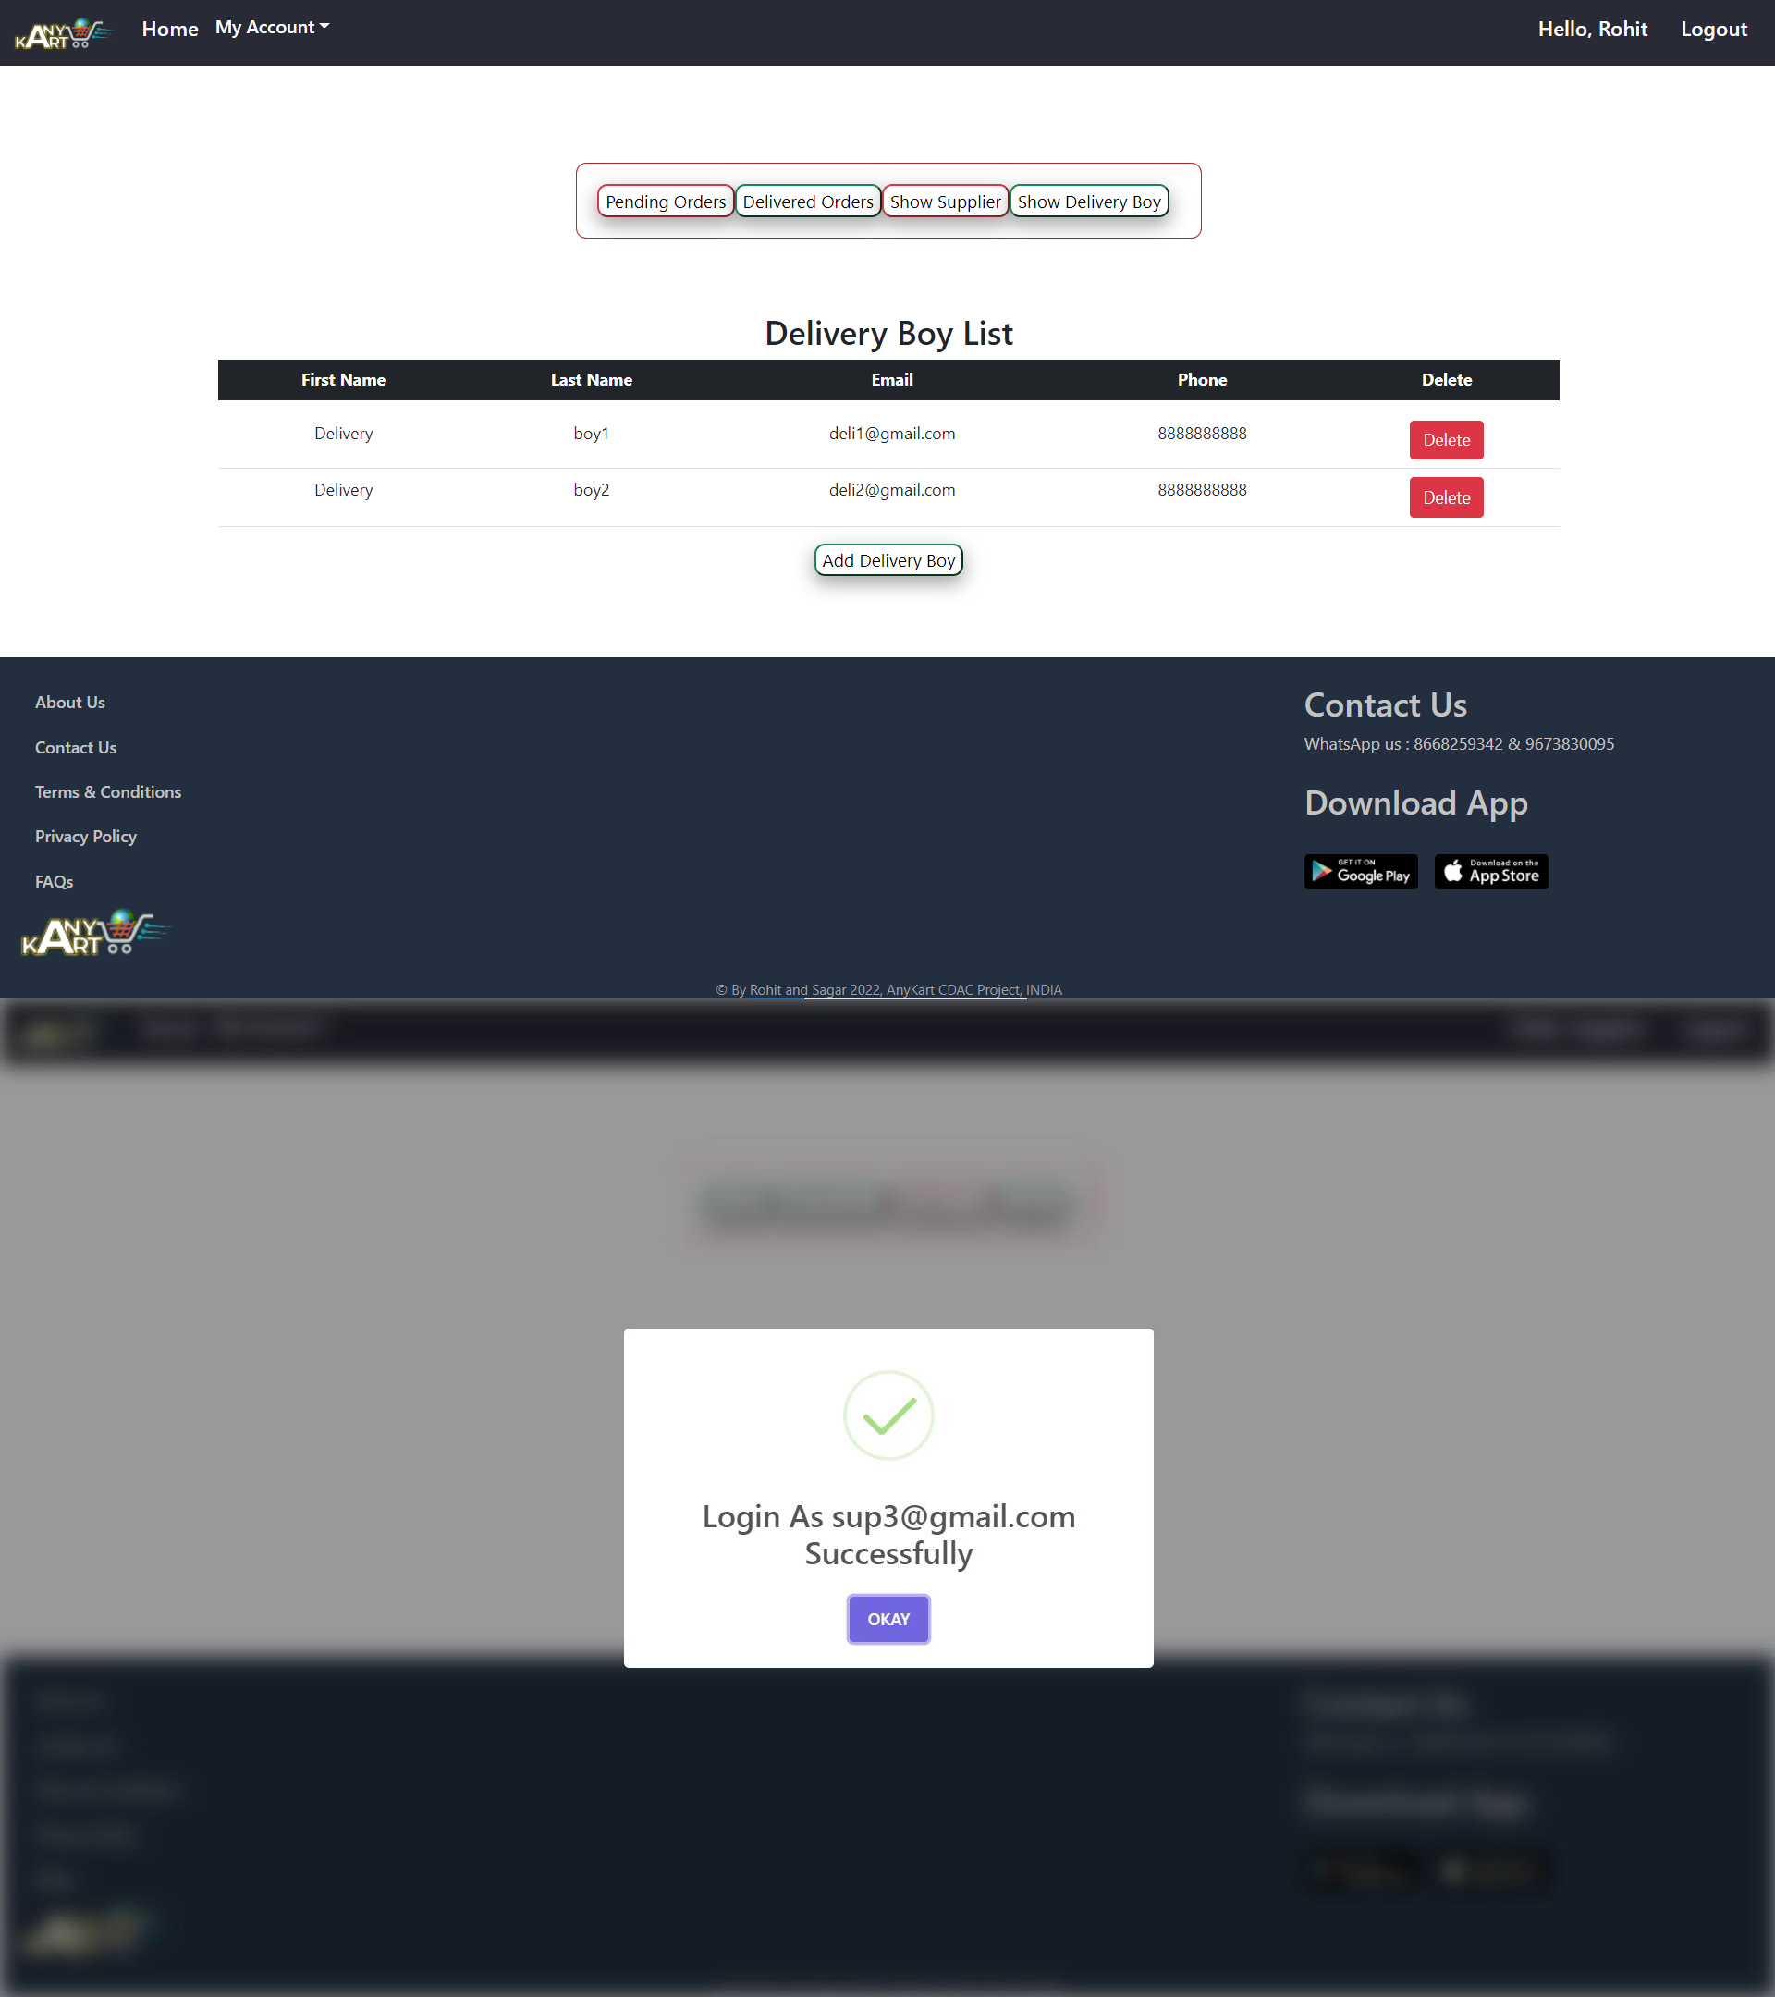
IACSD

Slide 32
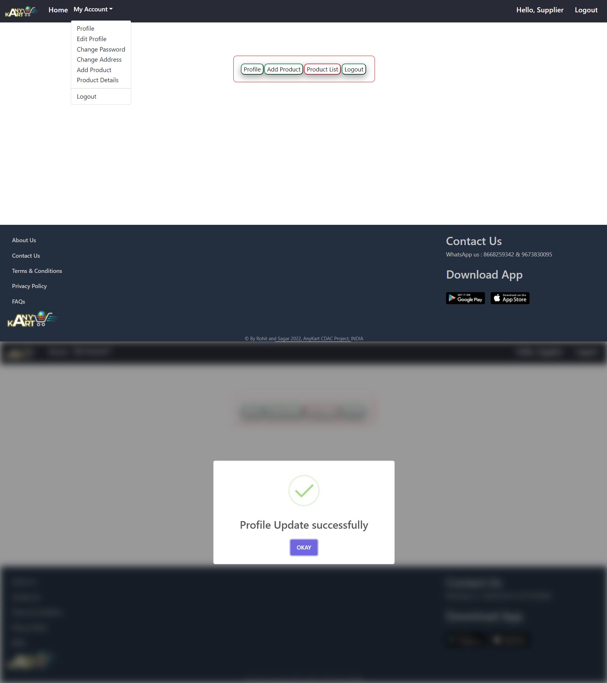
IACSD

Slide 33
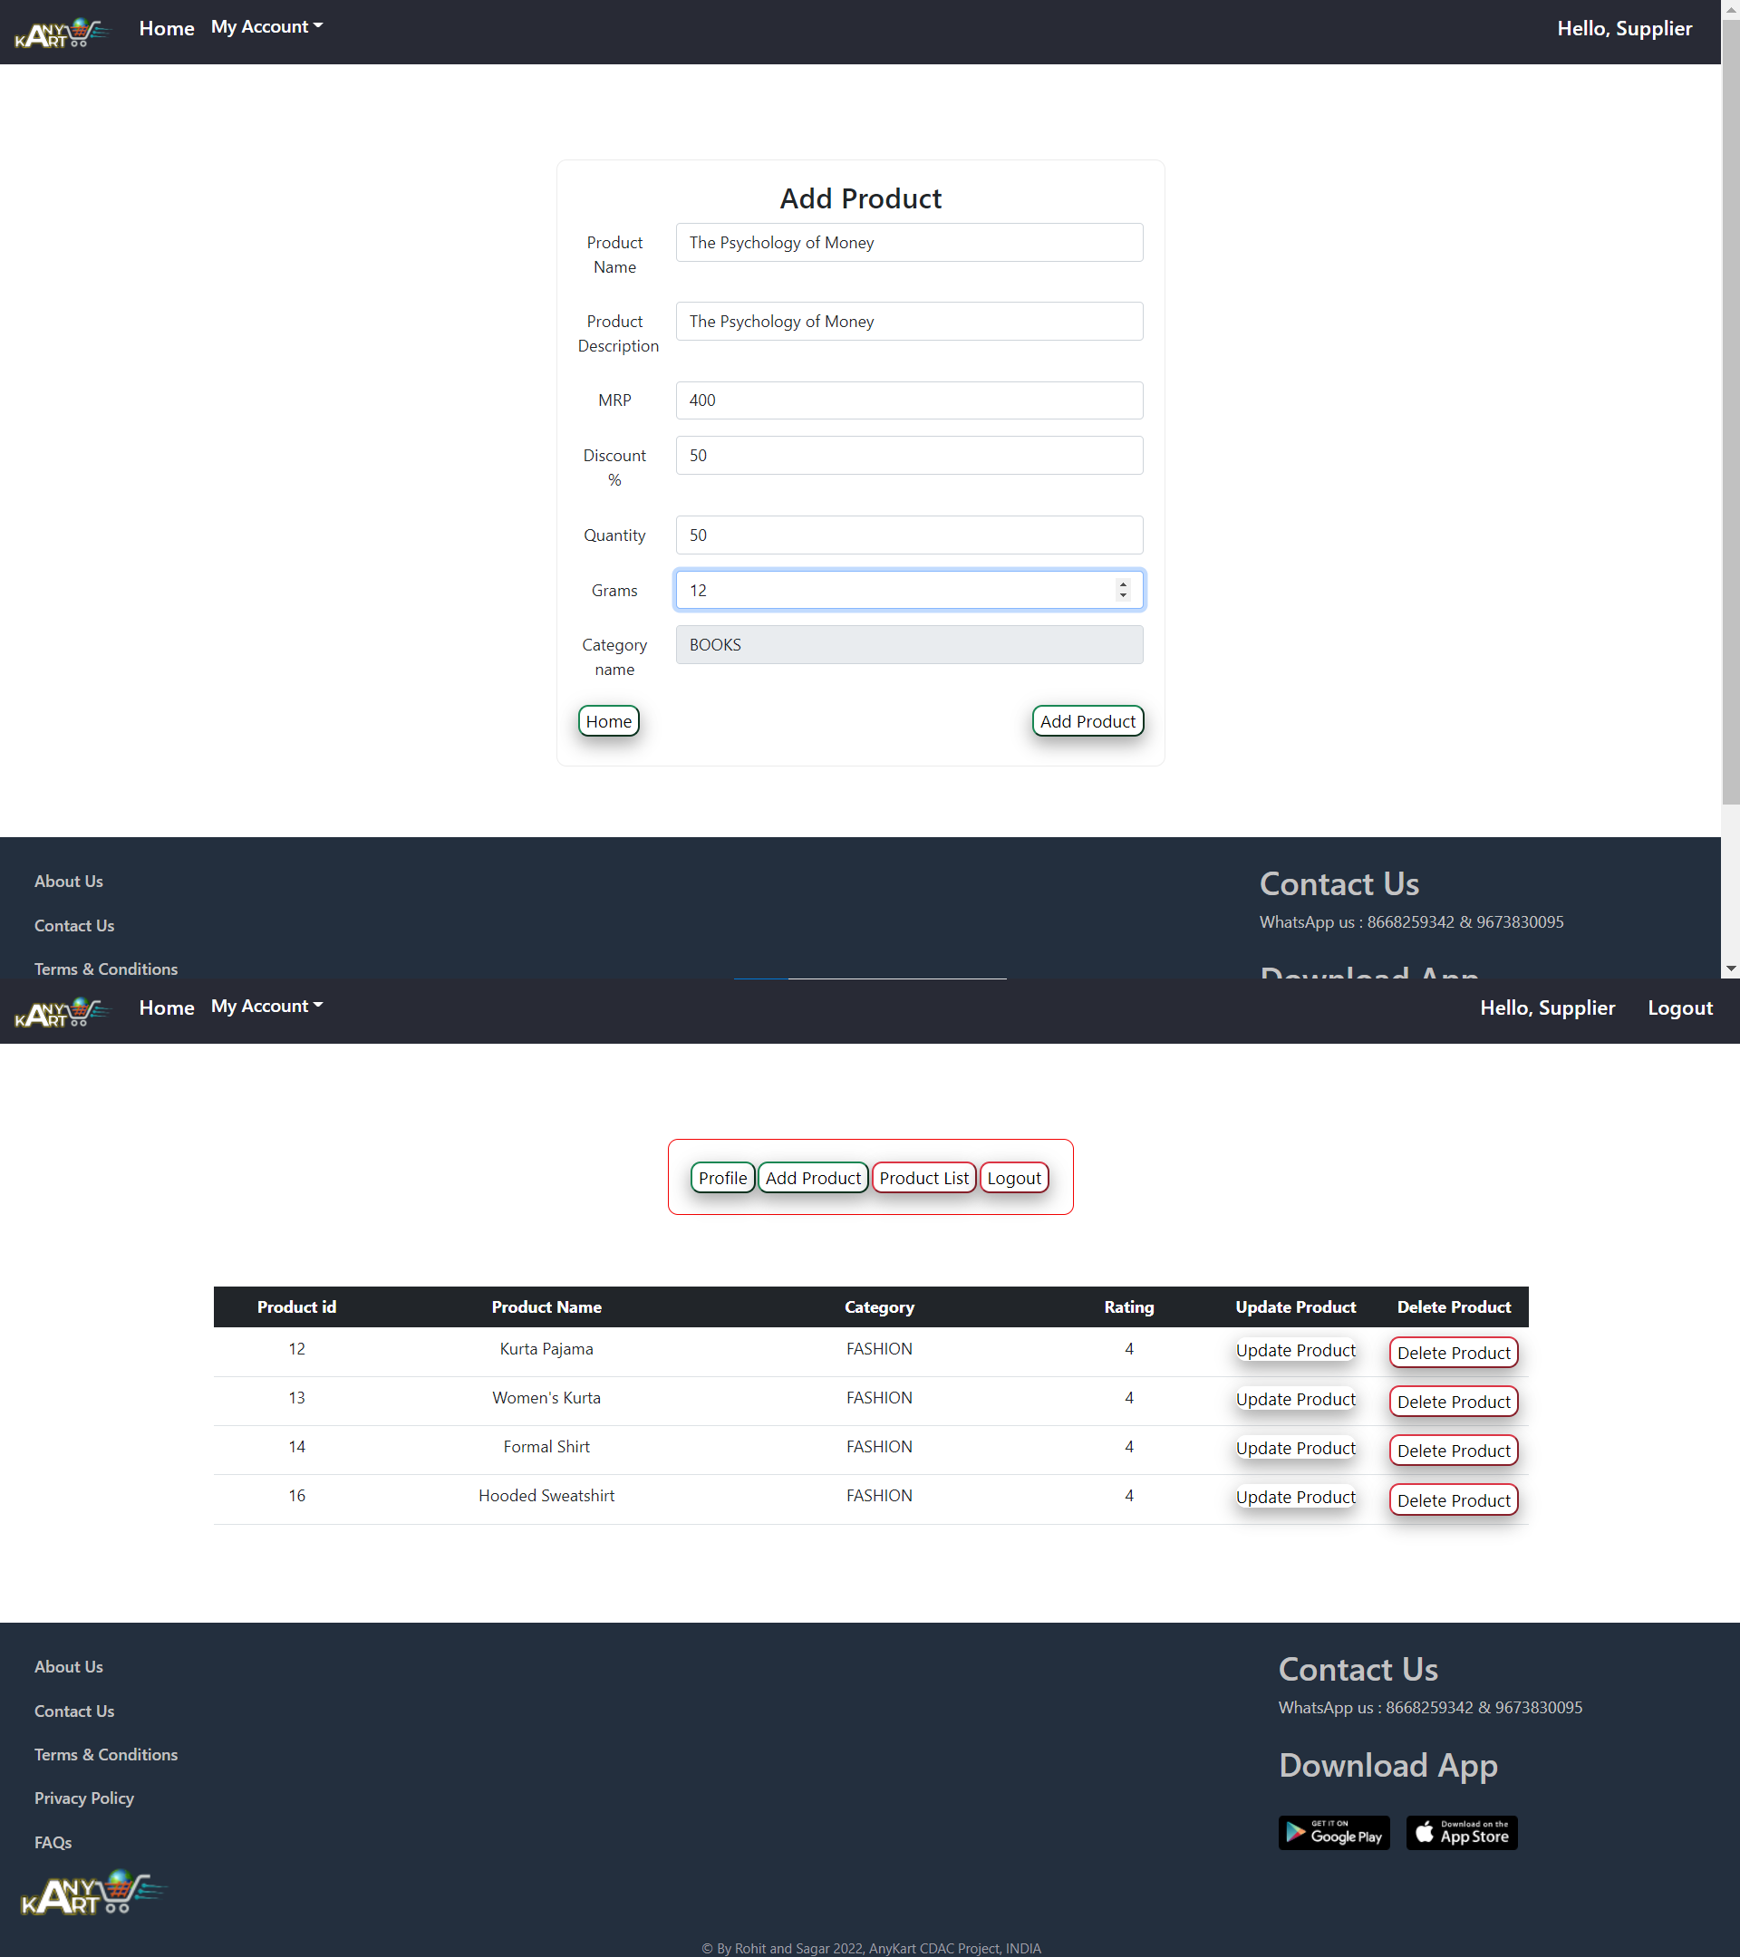
IACSD

Slide 34
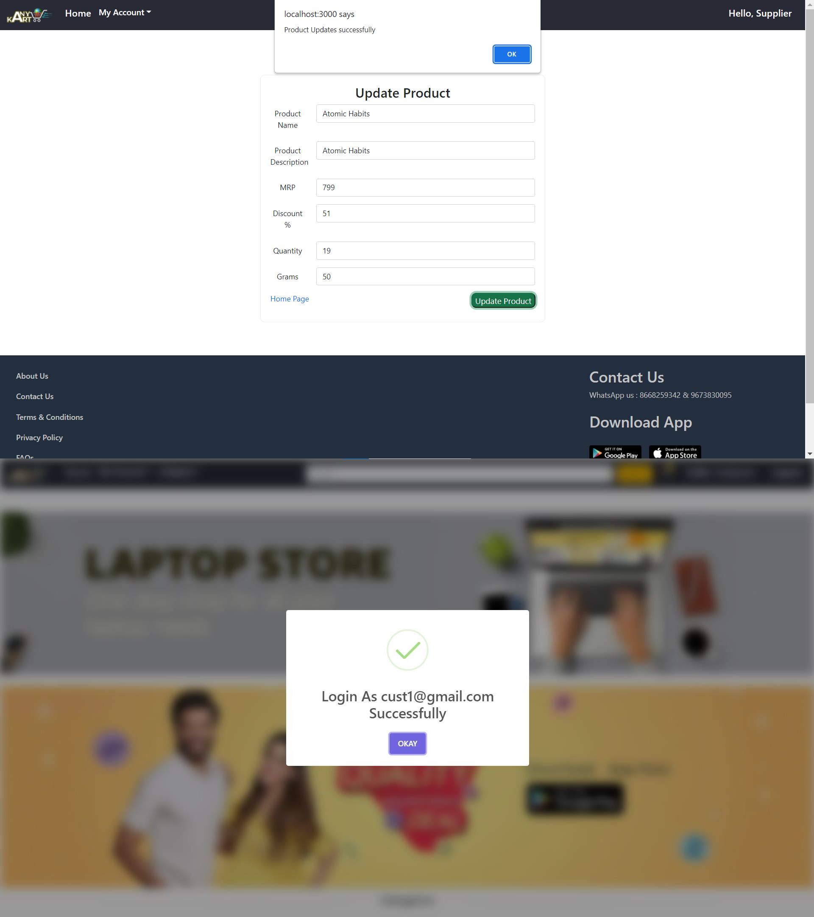
IACSD

Slide 35
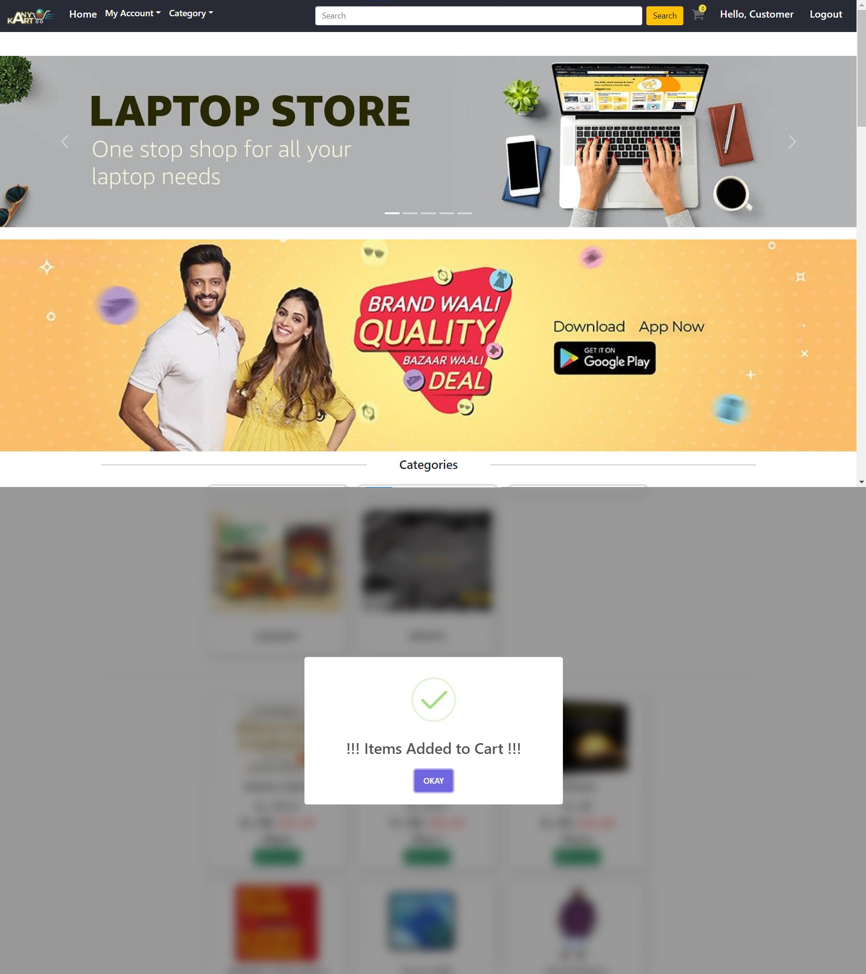
IACSD

Slide 36
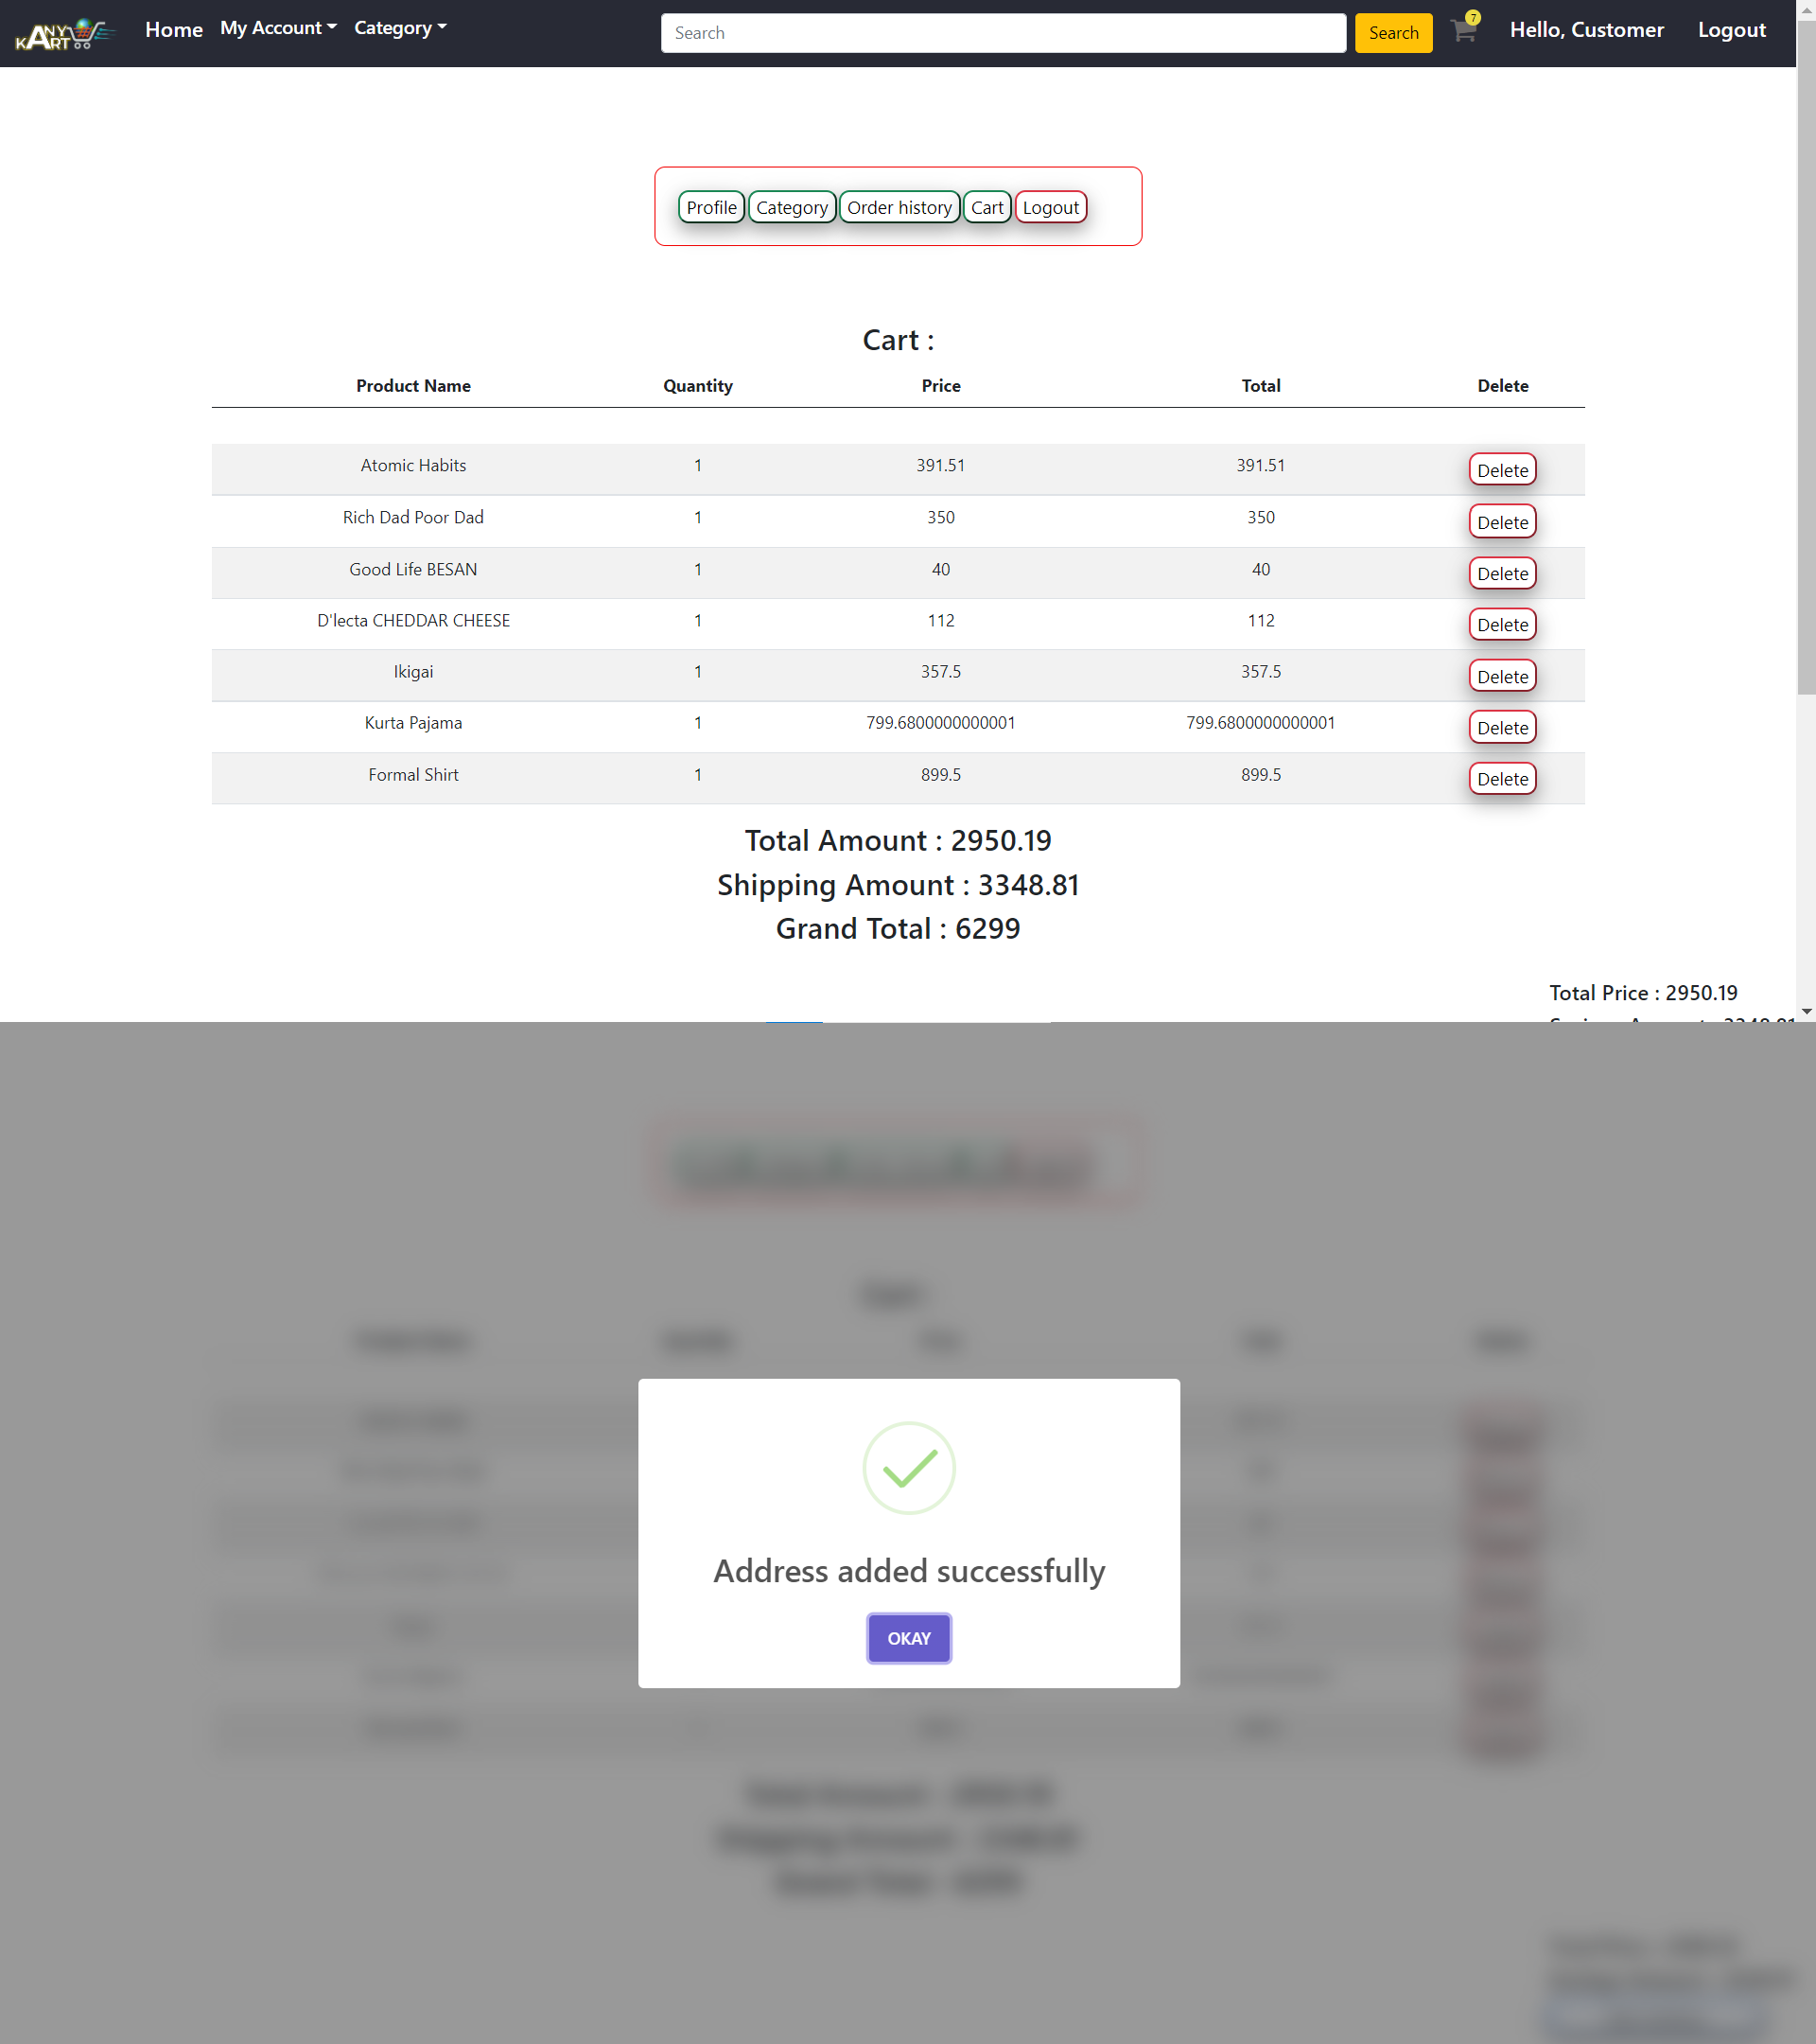
IACSD

Slide 37
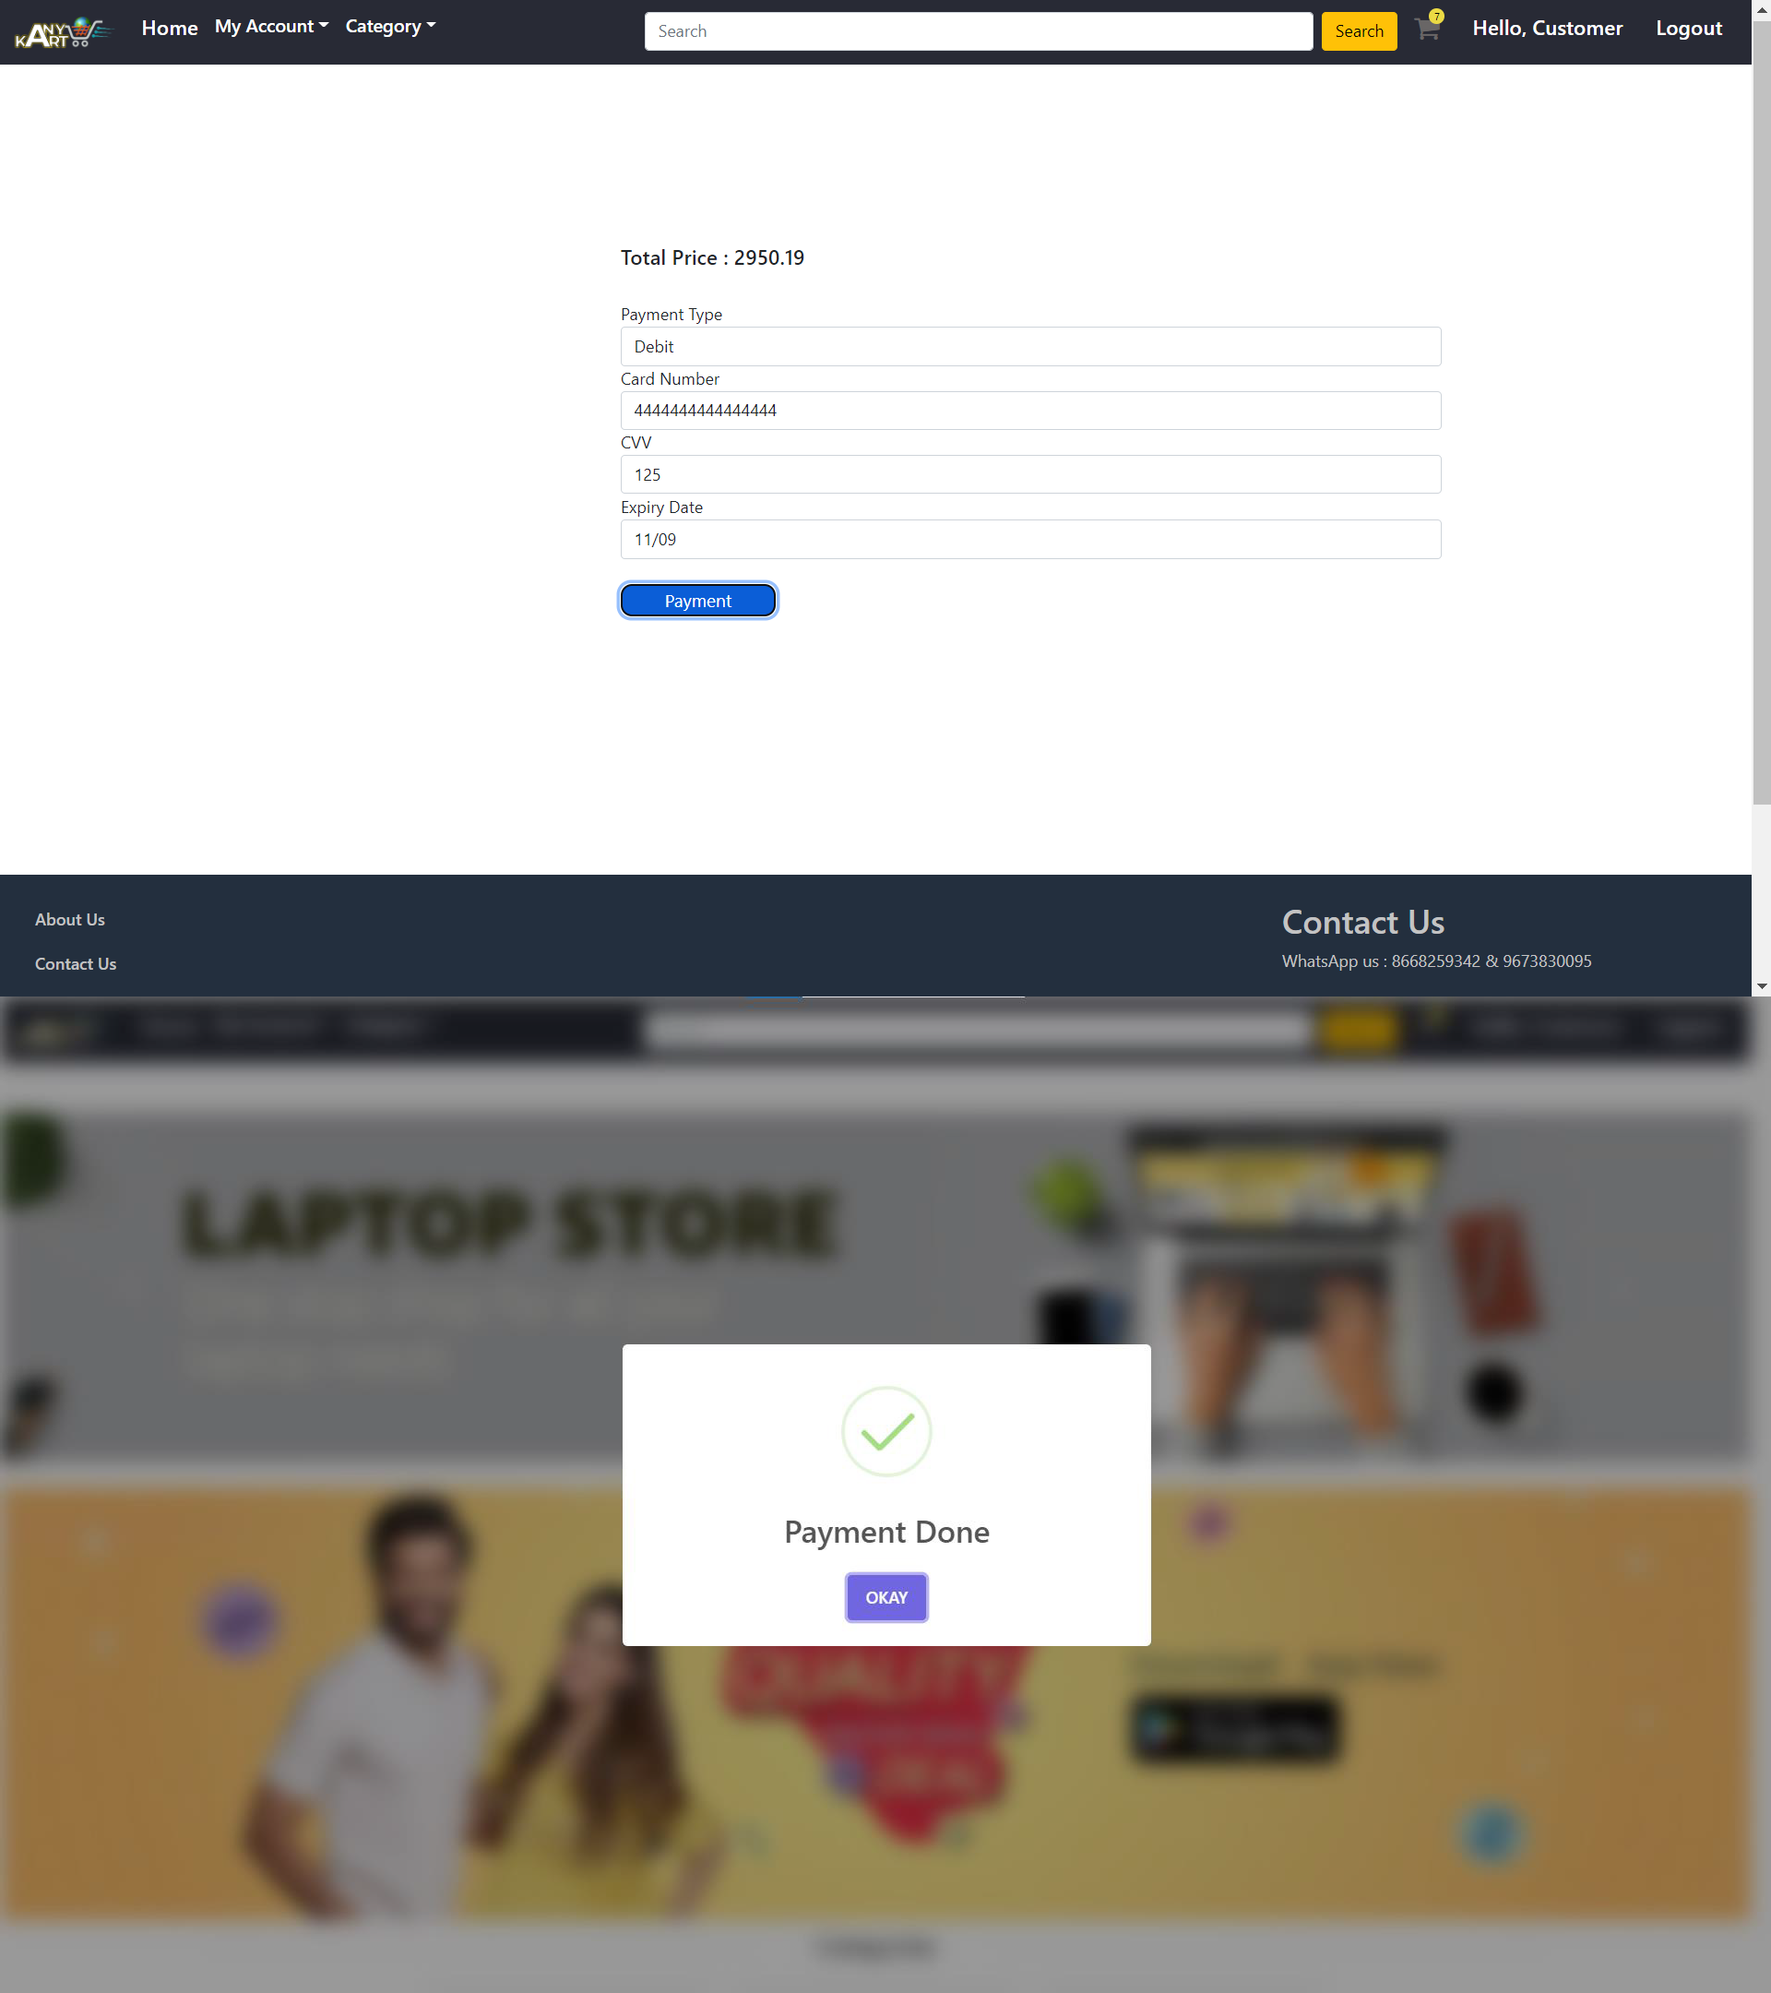
IACSD

Slide 38
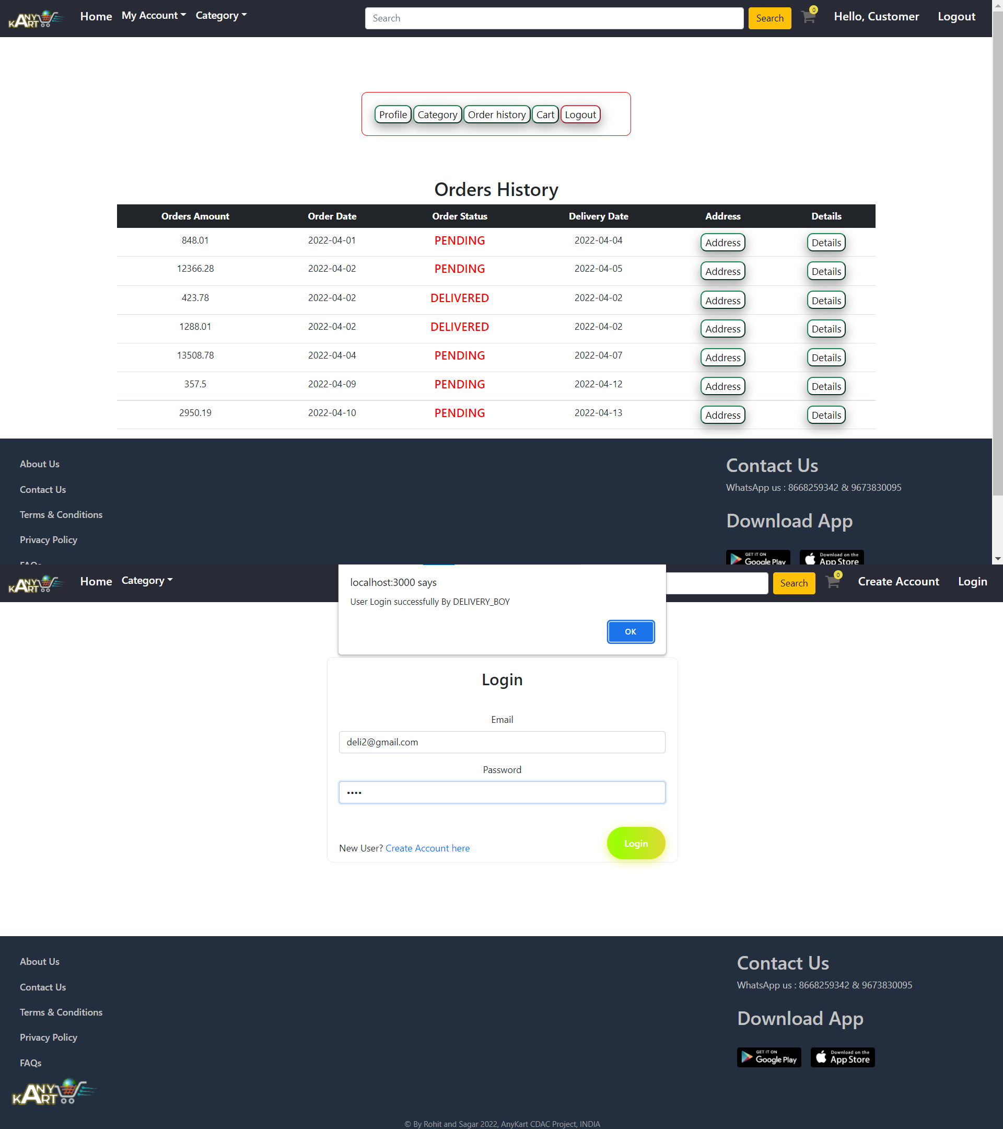
IACSD

Slide 39
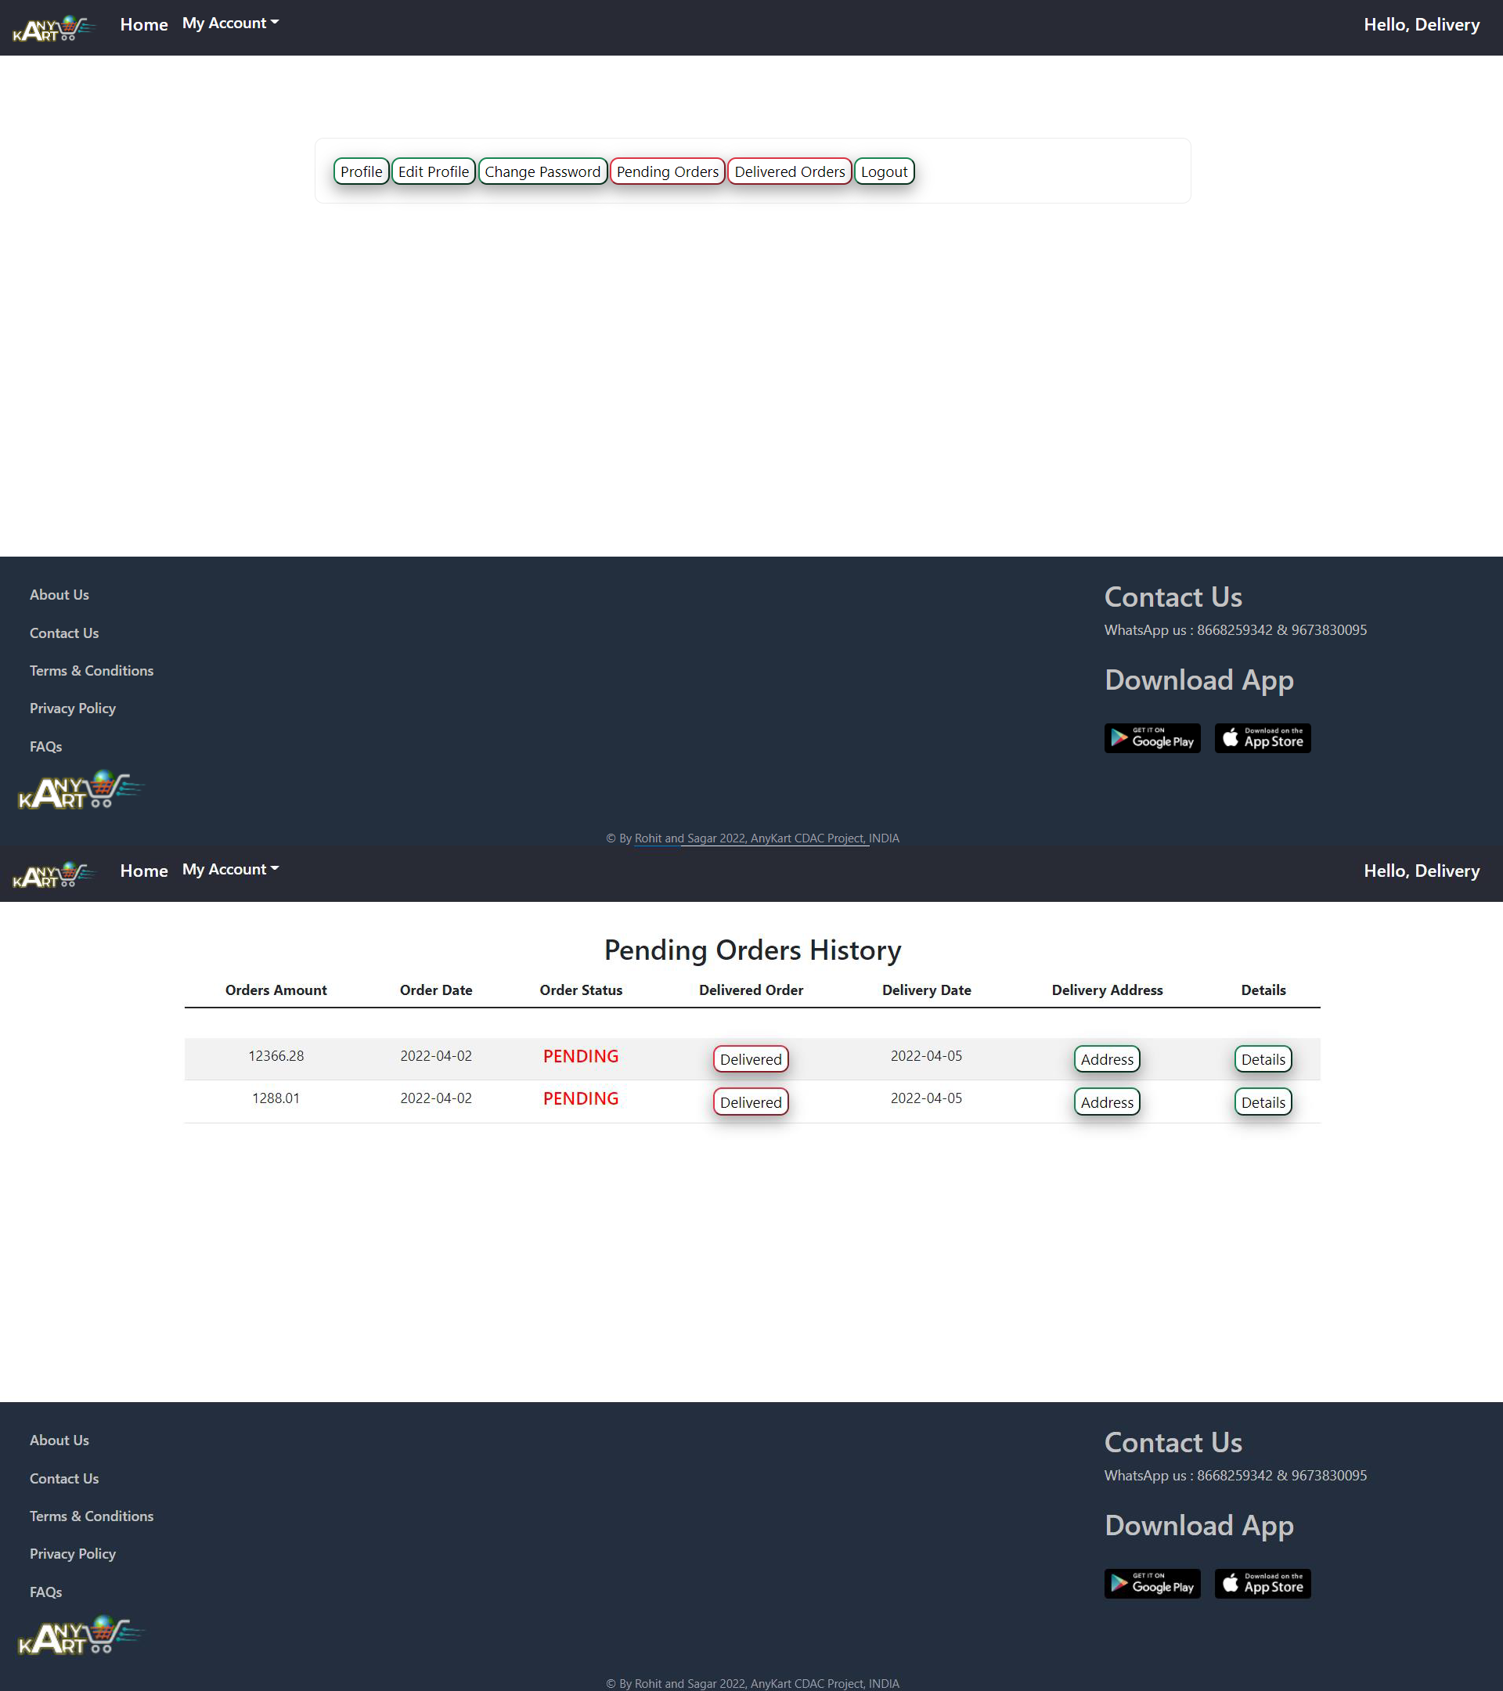
IACSD

Slide 40
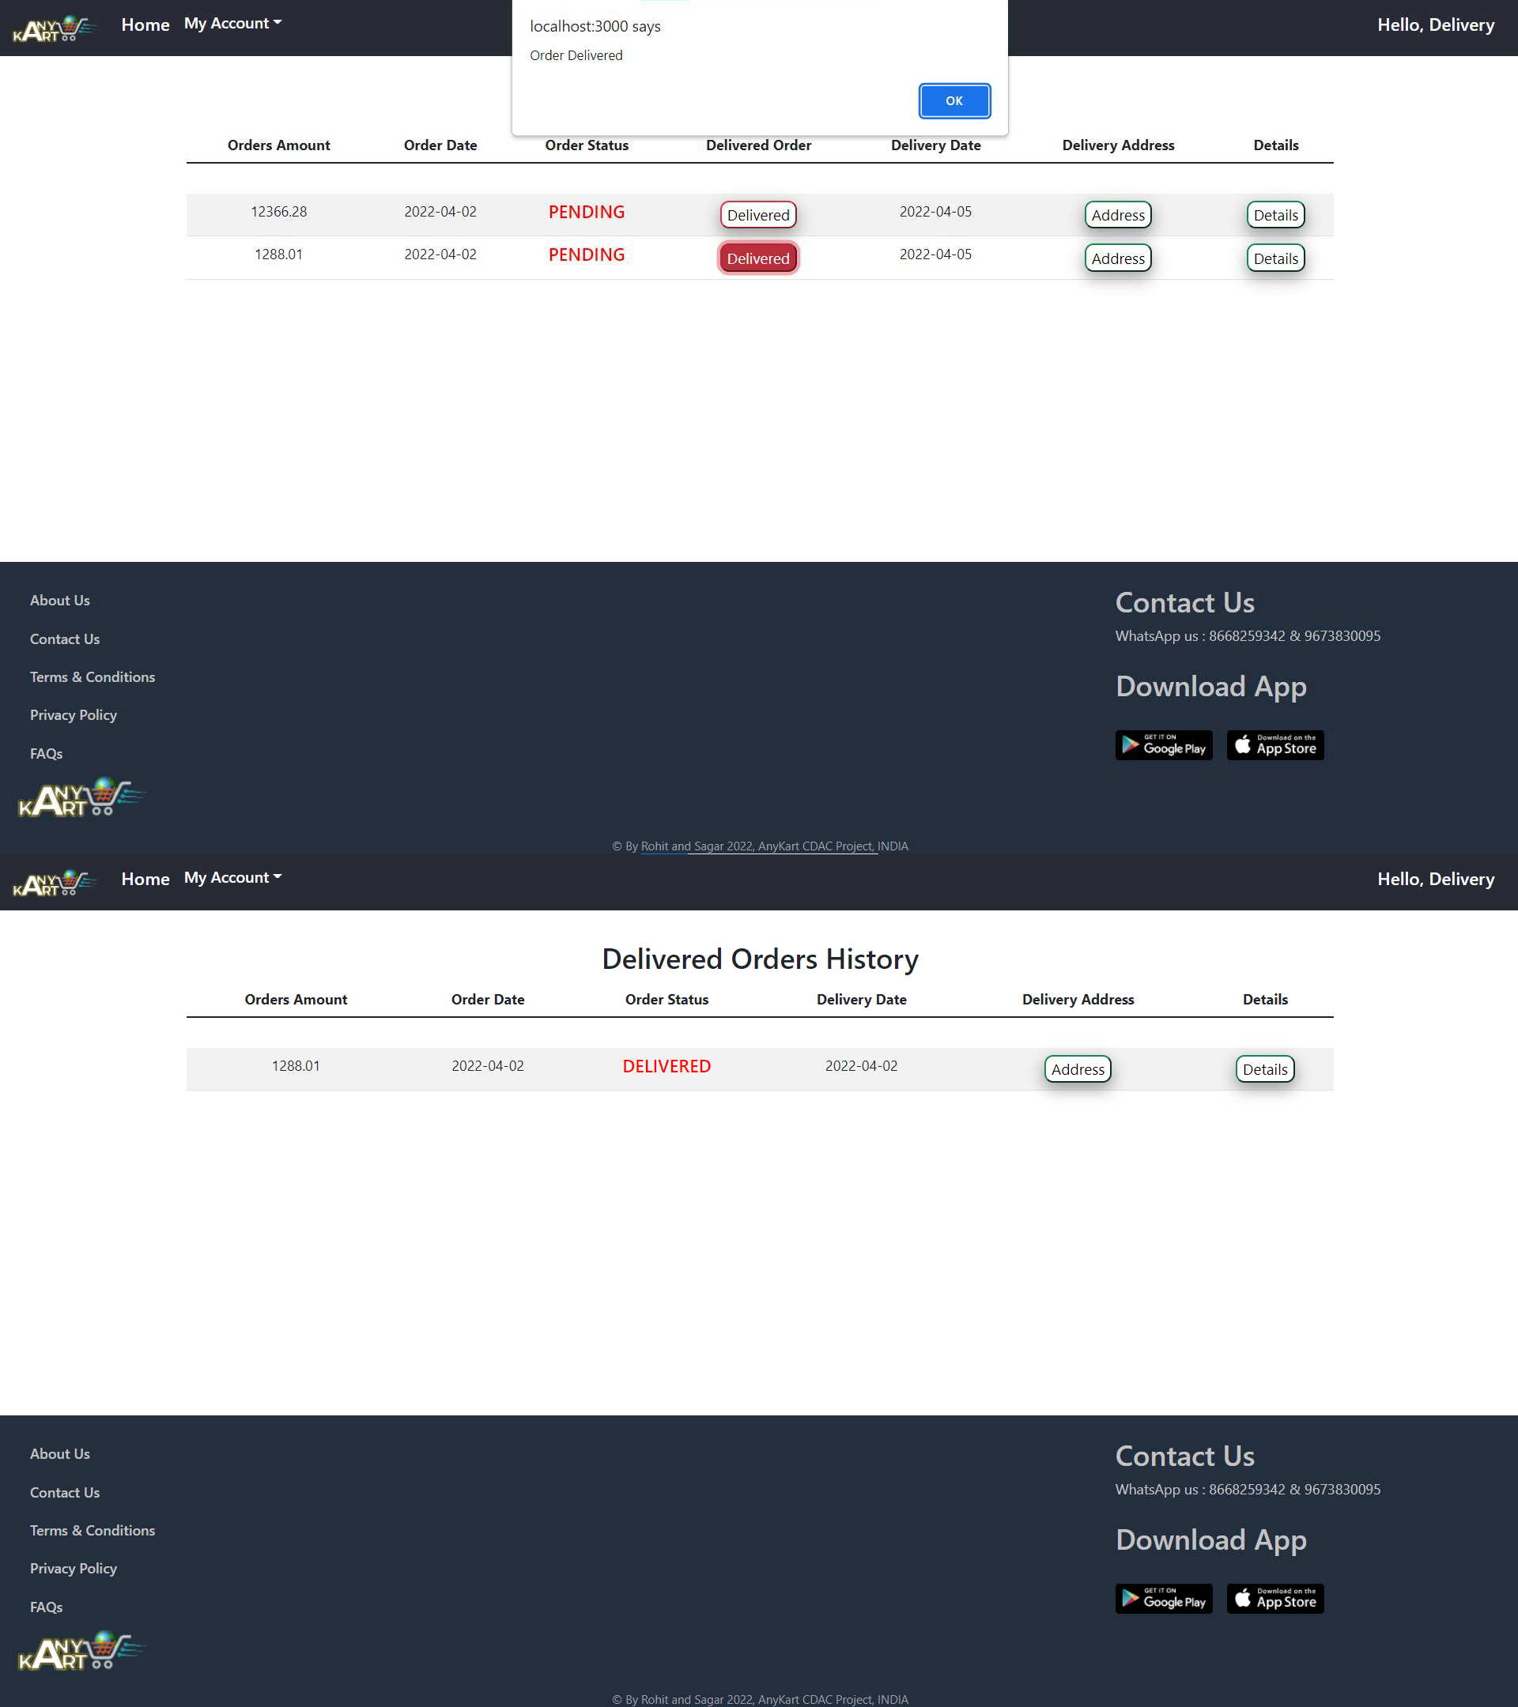
IACSD

Slide 41
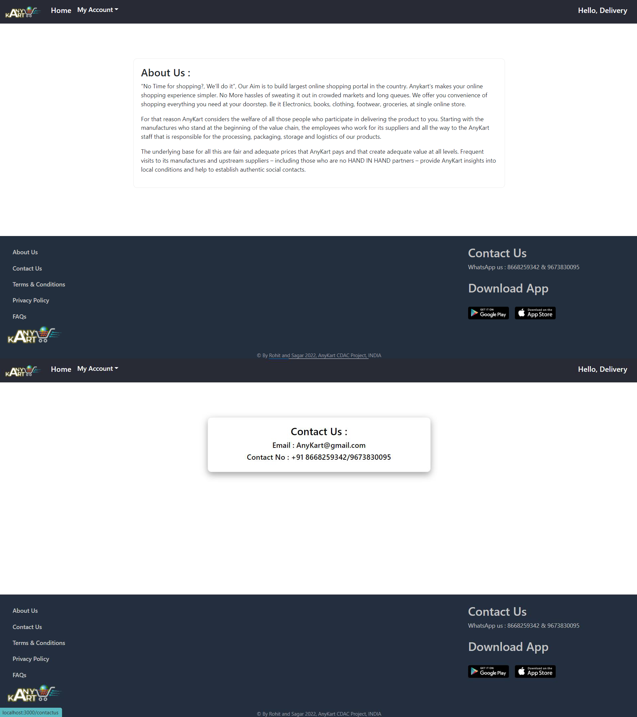
IACSD

Slide 42
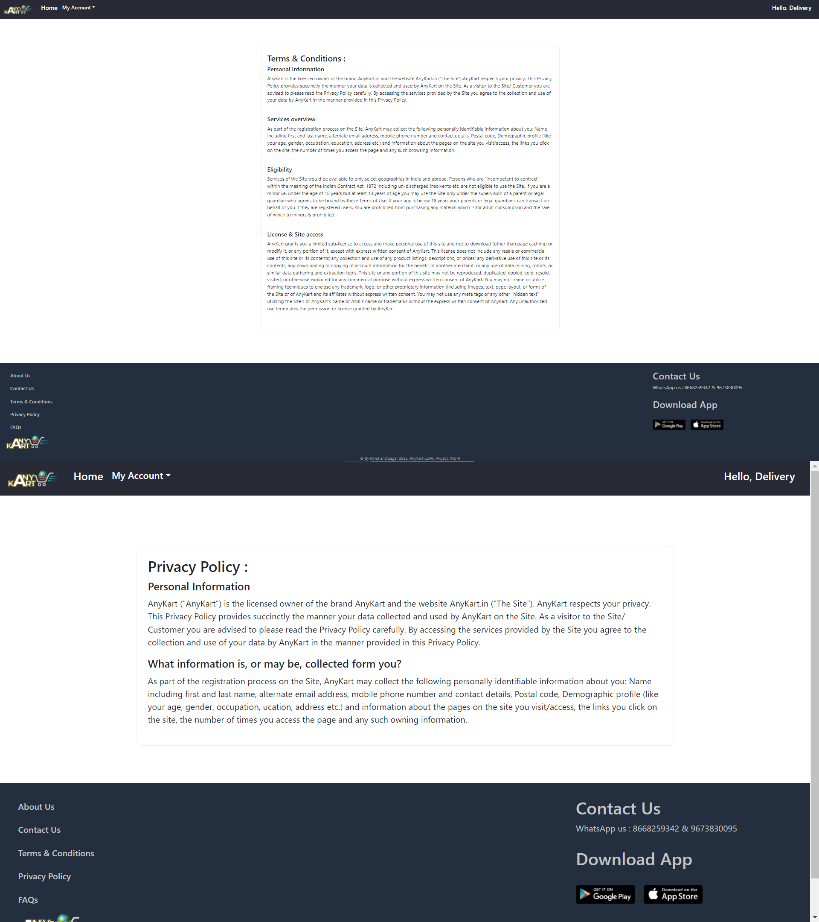
IACSD

Slide 43
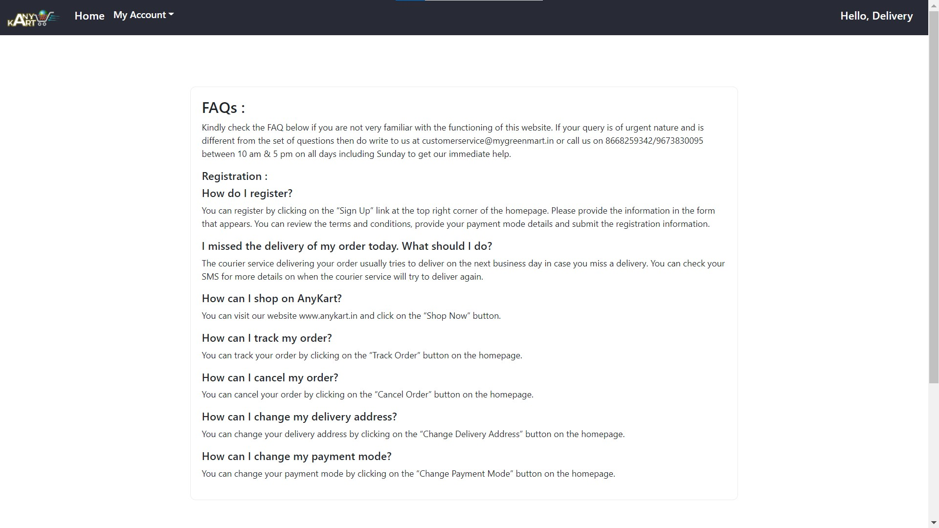
IACSD

Slide 44
IACSD
CONCLUSION
The project entitled Home Loan Service was completed successfully.
The system has been developed with much care and free of errors and at the same time it is efficient and less time consuming. The purpose of this project was to develop a web application for bank employees to create application
This project helped us in gaining valuable information and practical knowledge on several topics like designing web pages using React.js, usage of responsive templates, designing of android
applications, and management of database using MySQL. The entire system is secured. Also, the project helped us understanding about the development phases of a project and software development life cycle. We learned how to test different features of a project.
This project has given us great satisfaction in having designed an application which can be implemented to any nearby shops or branded shops selling various kinds of products by simple modifications.
There is a scope for further development in our project to a great extent. A number of features can be added to this system in future like providing moderator more control over products so that each moderator can maintain their own products. Another feature we wished to implement was providing classes for customers so that different offers can be given to each class. System may keep track of history of enquires of each customer and provide suggestions based on their history. These features could have implemented unless the time did not limit us. The web site provides synchronization between the employees of the bank. Here, the individual employee can find the data of all of all customers applying for loan, so that they can call them back for taking updates.
It saves a lot of time for processing the request of the application.

Slide 45
IACSD
REFERENCES
JavaScript Enlightenment, Cody Lindley-First Edition, based on JavaScript 1.5, ECMA-262,
Edition
Mc Graw Hill’s, Java: The complete reference 7thEdition, Herbert Scheldt
Complete CSS Guide, Maxine Sherrin and John Allsopp-O'ReillyMedia; September 2012
ONLINE REFERENCE
www.Google.com
www.w3school.com
www.javatpoint.com
www.geeksforgeeks.com

